Slide 1
SCILAB IMAGE PROCESSING TOOLBOX DEVELOPMENT
ZACHARIAH P JIJO

Slide 2
hough_line
hough
hough_circle
houghtf
houghpeaks
houghlines

Slide 3
hough_line
Computes the line transform using radians and native Octave conventions to build the raw voting matrix. It maps every edge pixel into a continuous sinusoidal curve based on the standard image origin.

Slide 4
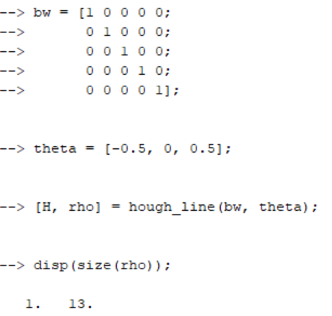

hough_line

Slide 5
hough
Computes the line transform using degrees to build a MATLAB-compatible voting matrix. It structures the accumulator array using familiar angle steps, making it easier to integrate with standard post-processing tools.

Slide 6
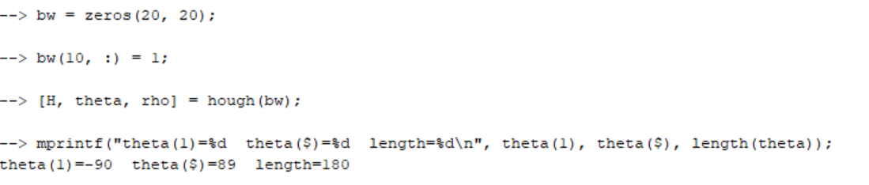
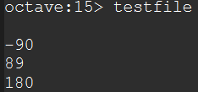
hough

Slide 7
hough_circle
Computes a specialized 3D transform that finds circles of target radii by allowing edge pixels to vote for potential center points. It maps 2D spatial pixels into a multi-layered voting space where the highest peaks reveal the center coordinates and sizes of circles.

Slide 8
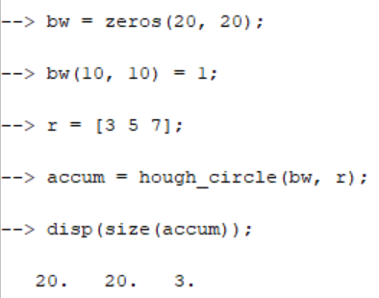

hough_circle

Slide 9
Acts as the low-level, high-performance underlying transformer engine that executes the raw pixel-looping and math. It accepts a parameter toggle to switch its internal logic between line tracking and circle tracking, serving as the foundational backbone for the user-facing functions.
houghtf

Slide 10
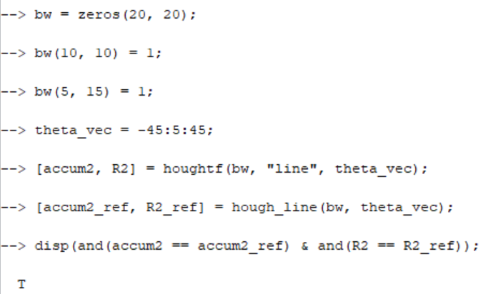

houghtf

Slide 11
Searches the voting matrix to isolate the coordinates of the strongest peaks that cross a minimum vote threshold. It suppresses nearby candidate lines to ensure a single physical line doesn't get detected multiple times.
houghpeaks

Slide 12
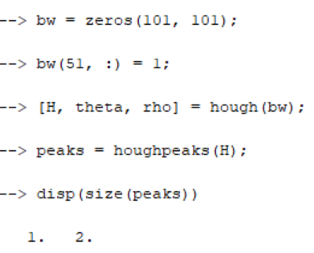

houghpeaks

Slide 13
Uses the peak coordinates from houghpeaks to trace back to the original image and extract the exact start and stop points of the line segments. It connects broken edges and fills in small gaps caused by noise or thresholding.
houghlines

Slide 14
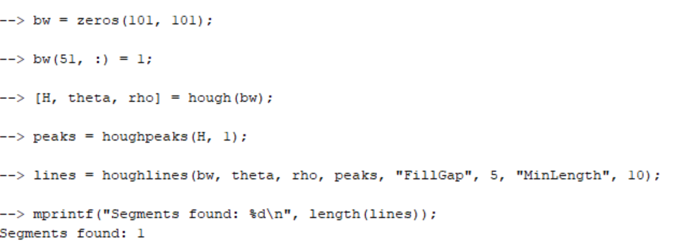

houghlines

Slide 15
isind
imcast
im2single
imreconstruct
conndef
imhmax
imcomplement
imhmin
colorangle

Slide 16
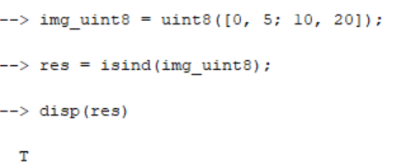

Checks if an image is an indexed image by verifying if it is a numeric matrix containing valid, non-negative integer color indices. It returns a simple true/false flag, allowing processing pipelines to decide whether an accompanying color map is required to read the image data.
isind

Slide 17
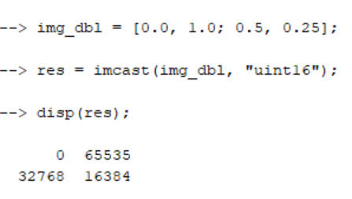

Converts an image from one data type to another (like uint8 to double) while automatically scaling the underlying pixel intensity values to prevent clipping. It safely scales the data so that maximum brightness translates perfectly between formats, such as converting 255 in an 8-bit integer to 1.0 in a floating-point number.
imcast

Slide 18
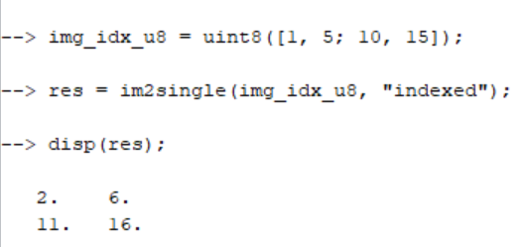

Rescales and converts an image matrix into single-precision floating-point format (single). It shifts integer pixel values from their native ranges down to a standard 0.0-to-1.0 scale, maximizing memory savings and calculation speed during complex filter operations.
im2single

Slide 19
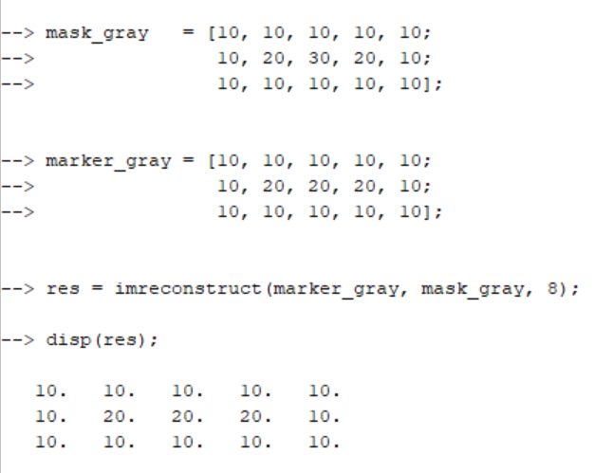
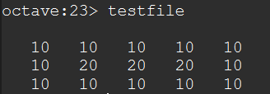
Performs morphological image reconstruction by repeatedly dilating a "marker" image inside the boundaries of a "mask" image until the shapes stabilize. It is highly effective for isolating specific target objects or removing background noise without altering the original boundaries of the remaining shapes.
imreconstruct

Slide 20
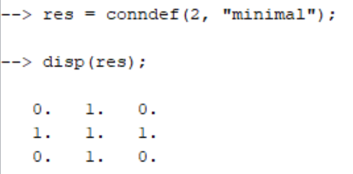
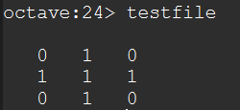
Defines the standard connectivity arrays used in neighborhood-based pixel operations like dilation or erosion. It allows you to quickly generate standard structural matrices – such as 4-connected or 8-connected grids – ensuring consistent neighbor tracking across different image dimensions.
conndef

Slide 21
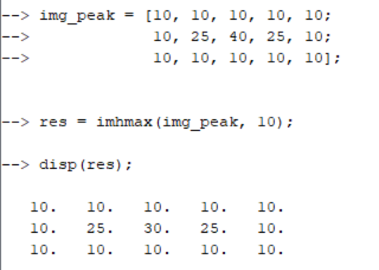
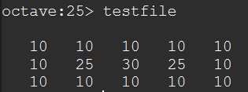
Suppresses all local intensity peaks in a grayscale image that are lower than a specified height threshold (h). It flattens out minor surface fluctuations and small image noise while preserving the shape and location of the dominant, major structural peaks.
imhmax

Slide 22
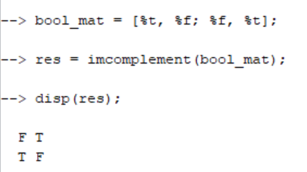

Computes the digital negative of an image by flipping all intensity values to their exact opposite states. It subtracts integer pixel values from their maximum possible capacity (such as 255 for 8-bit images) and flips binary images so that black pixels become white and white pixels become black.
imcomplement

Slide 23
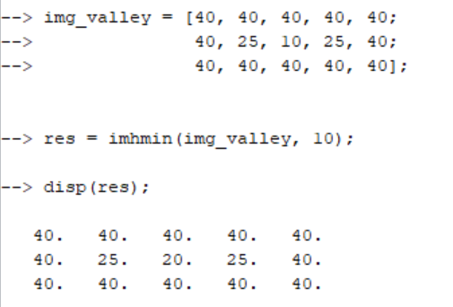
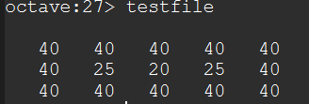
Suppresses all local intensity valleys (low points) in a grayscale image that are shallower than a specified depth threshold (h). It fills in minor dark dips and small local holes, which prevents background textures from causing false detections during subsequent segmentation.
imhmin

Slide 24
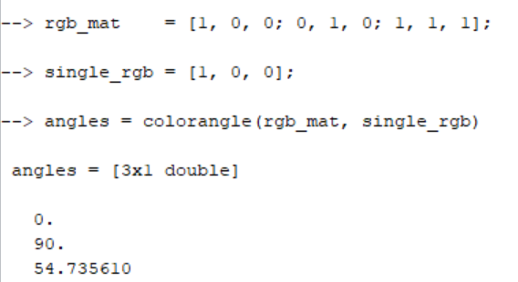
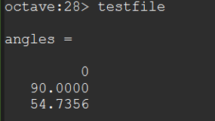
Computes the geometric angle in degrees between two RGB color vectors, treating each color as a 3D coordinate point (R, G, B) originating from the black point (0,0,0). It is widely used as an angular error metric in color-constancy and white-balancing pipelines to evaluate how closely an estimated light source matches the true background lighting of a scene.
colorangle

Slide 25
THANK YOU

