Slide 1



Fellowship Report:
Spiking Neural Networks
Case Studies in Scilab
Sumat Dhuwariya | VIT Bhopal University
Mentors: Prof. Prabhu Ramchandran & Mrs. Rashmi Patankar
July 1, 2026 | FOSSEE Summer Fellowship

Slide 2


The Challenge of Neural Simulation
Biophysical Accuracy
Computational Efficiency
Traditional models like Hodgkin-Huxley offer high biological realism by modeling individual ion channels.
Simplified models (e.g., Integrate-and-Fire) allow simulation of millions of neurons but fail to capture rich firing dynamics.
However, they are computationally prohibitive for large-scale networks due to high dimensionality.
Our goal: Bridge this gap using the Izhikevich Model within the open-source Scilab environment.

Slide 3
Fellowship Scope & Methodology
CS 1: Handwritten Digit Classification using 64-input SNN architecture.
CS 2: Modeling biological chemical synapses via First-Order kinetics in Xcos.
CS 3: Interactive Dashboard for Izhikevich firing patterns & Network rhythms.

Slide 4
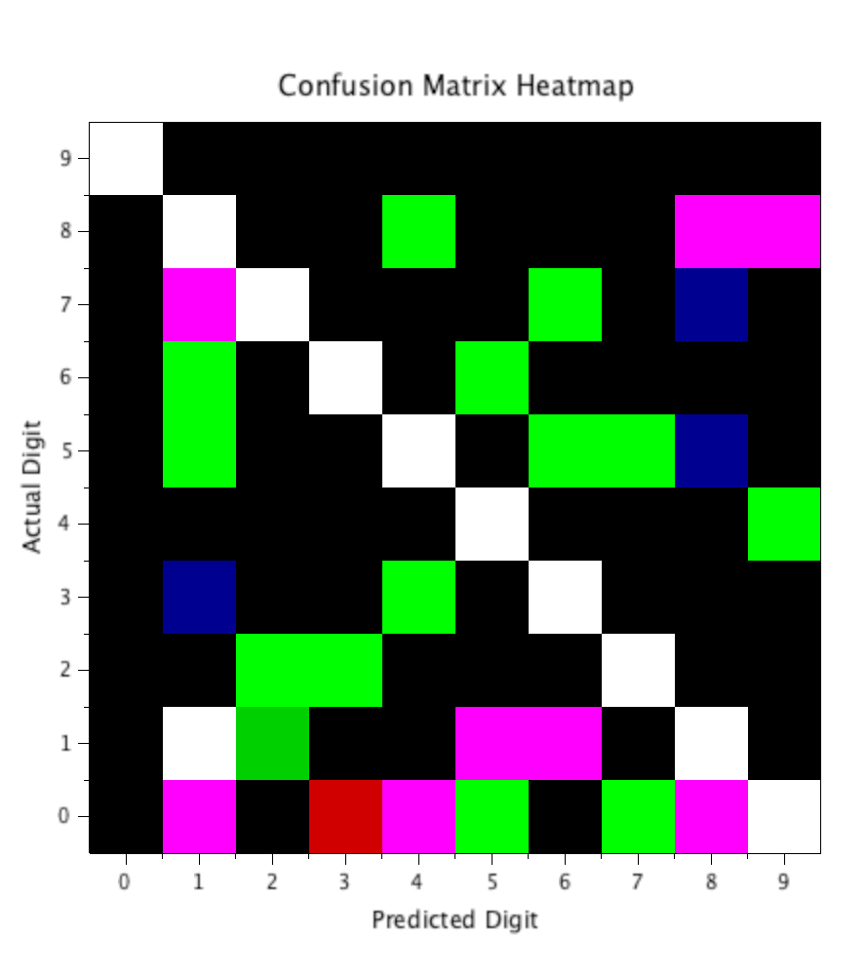
Case Study 1: SNN Image Classification
Translating static images into stochastic spikes using Poisson Encoding.
A supervised Spike-Perceptron learning rule was implemented to train the network on 8x8 digit matrices.

Slide 5
Case Study 1: Performance Metrics
91.90%
Balanced Learning
Proximity of Macro F1-Score (92.03%) to Global Accuracy validates balanced learning across all ten digit classes.
CLASSIFICATION ACCURACY
Incorporated L2 Regularization and Momentum-assisted weight updates to prevent overfitting on overlapping structures like 8 and 9.

Slide 6

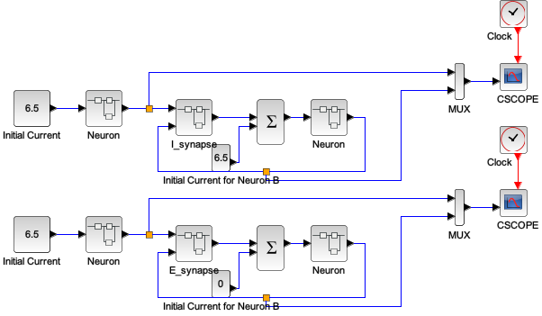
Case Study 2: Hodgkin-Huxley Synapses
Continuous-Time Xcos Blocks
Eliminated artificial square-wave pulses in favor of First-Order kinetics derived from AMPA/GABA receptor properties.
Synaptic interaction between two HH neurons modeled with reconfigurable superblocks for high fidelity.

Slide 7


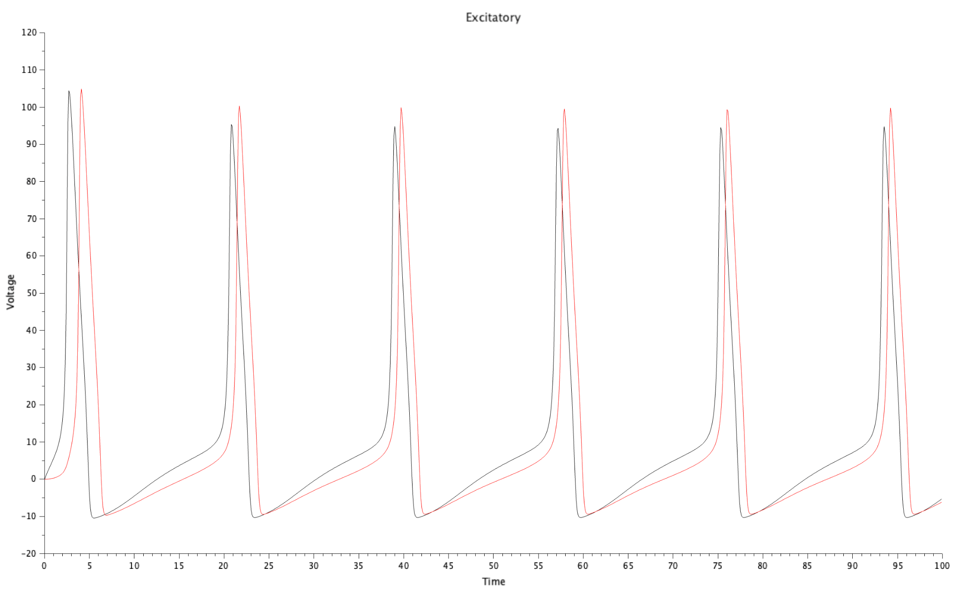
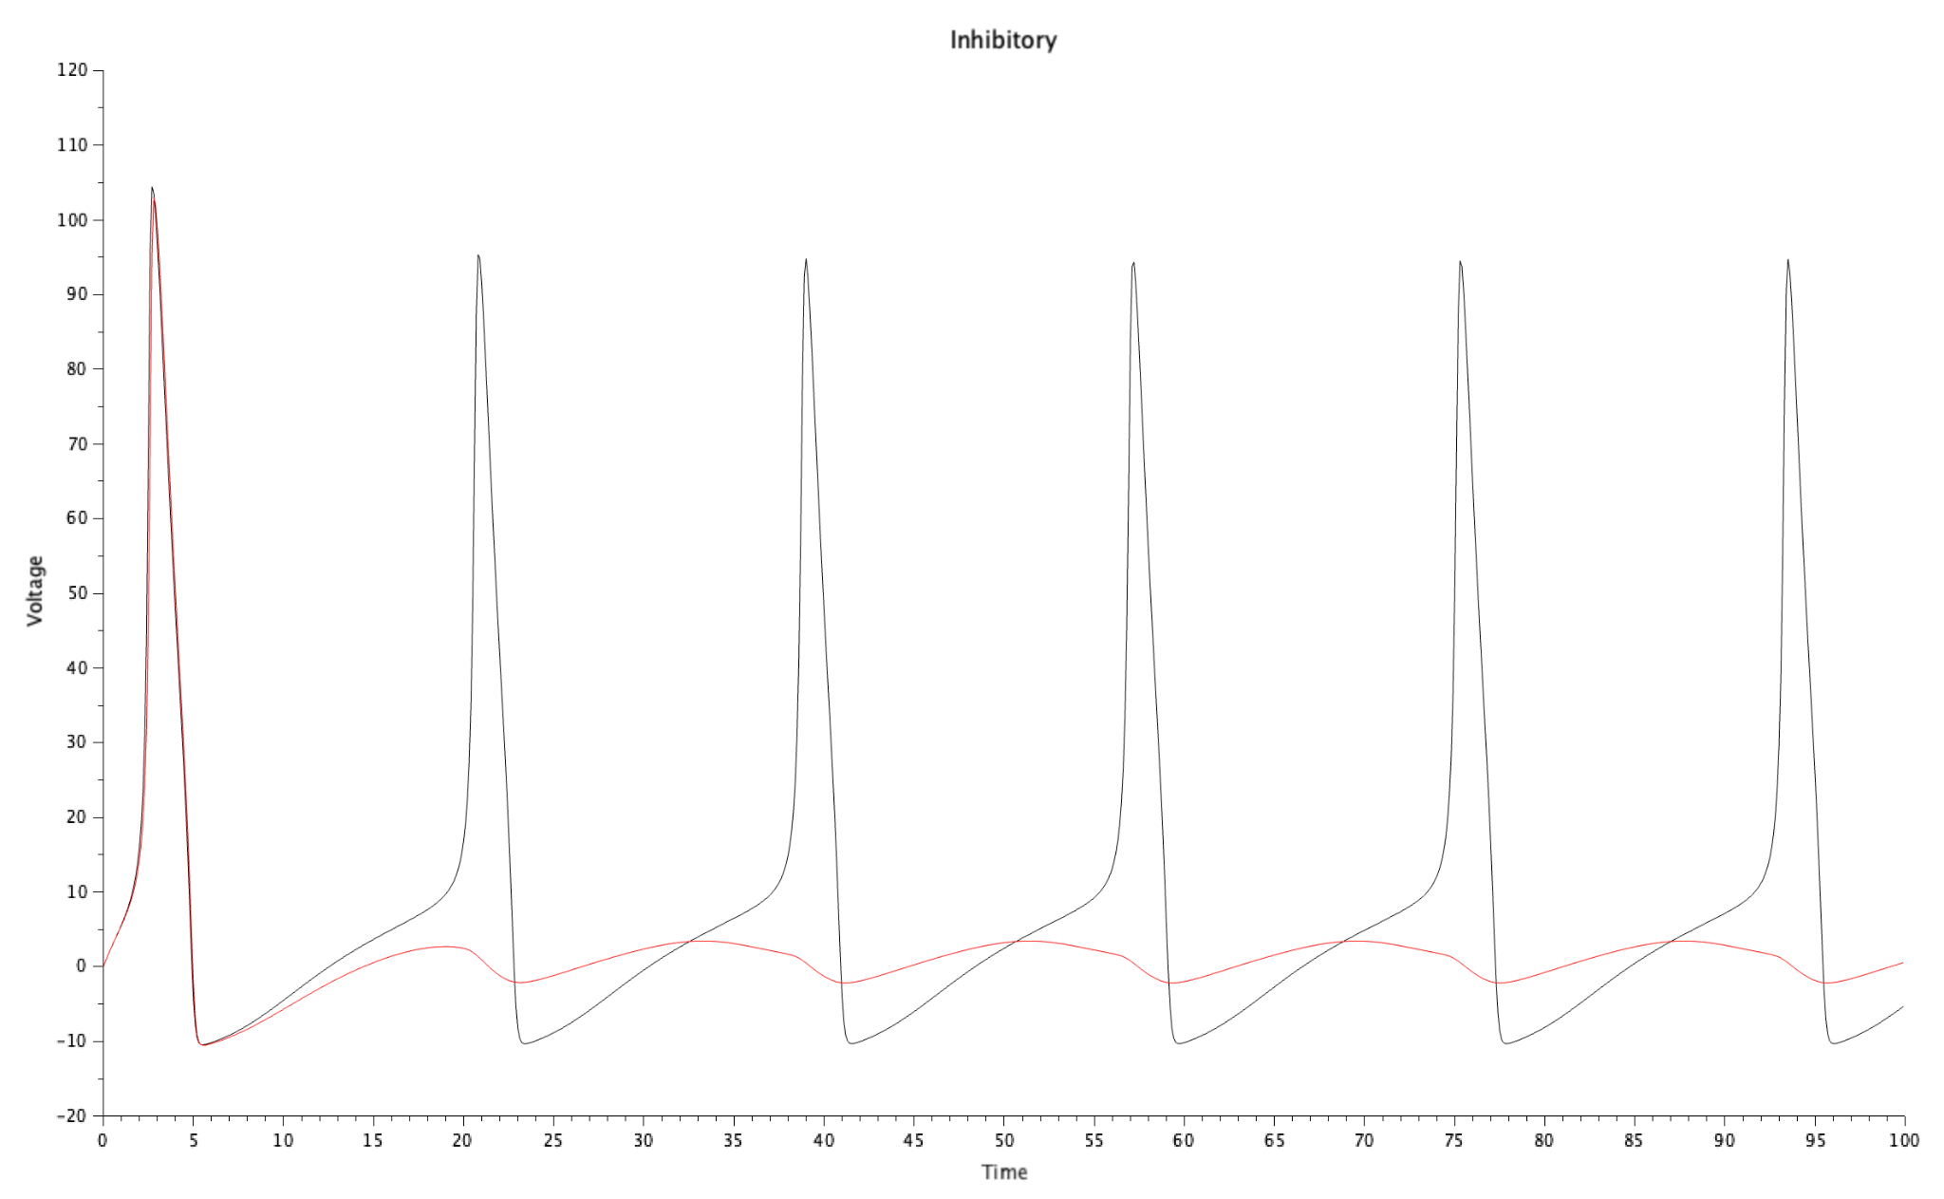
Case Study 2: EPSP vs. IPSP Validation
Excitatory (EPSP)
Inhibitory (IPSP)
Reversal potential set to Sodium (115mV).
Reversal potential set to Potassium (-12mV).
Pre-synaptic firing actively drives the post-synaptic voltage toward the threshold, causing a chain reaction of spikes.
Negative current injection drags the target neuron membrane downward, suppressing spike initiation even under stimulus.

Slide 8
Case Study 3:
The Izhikevich Model
8 Canonical Firing Patterns and Cortical Dynamics

Slide 9

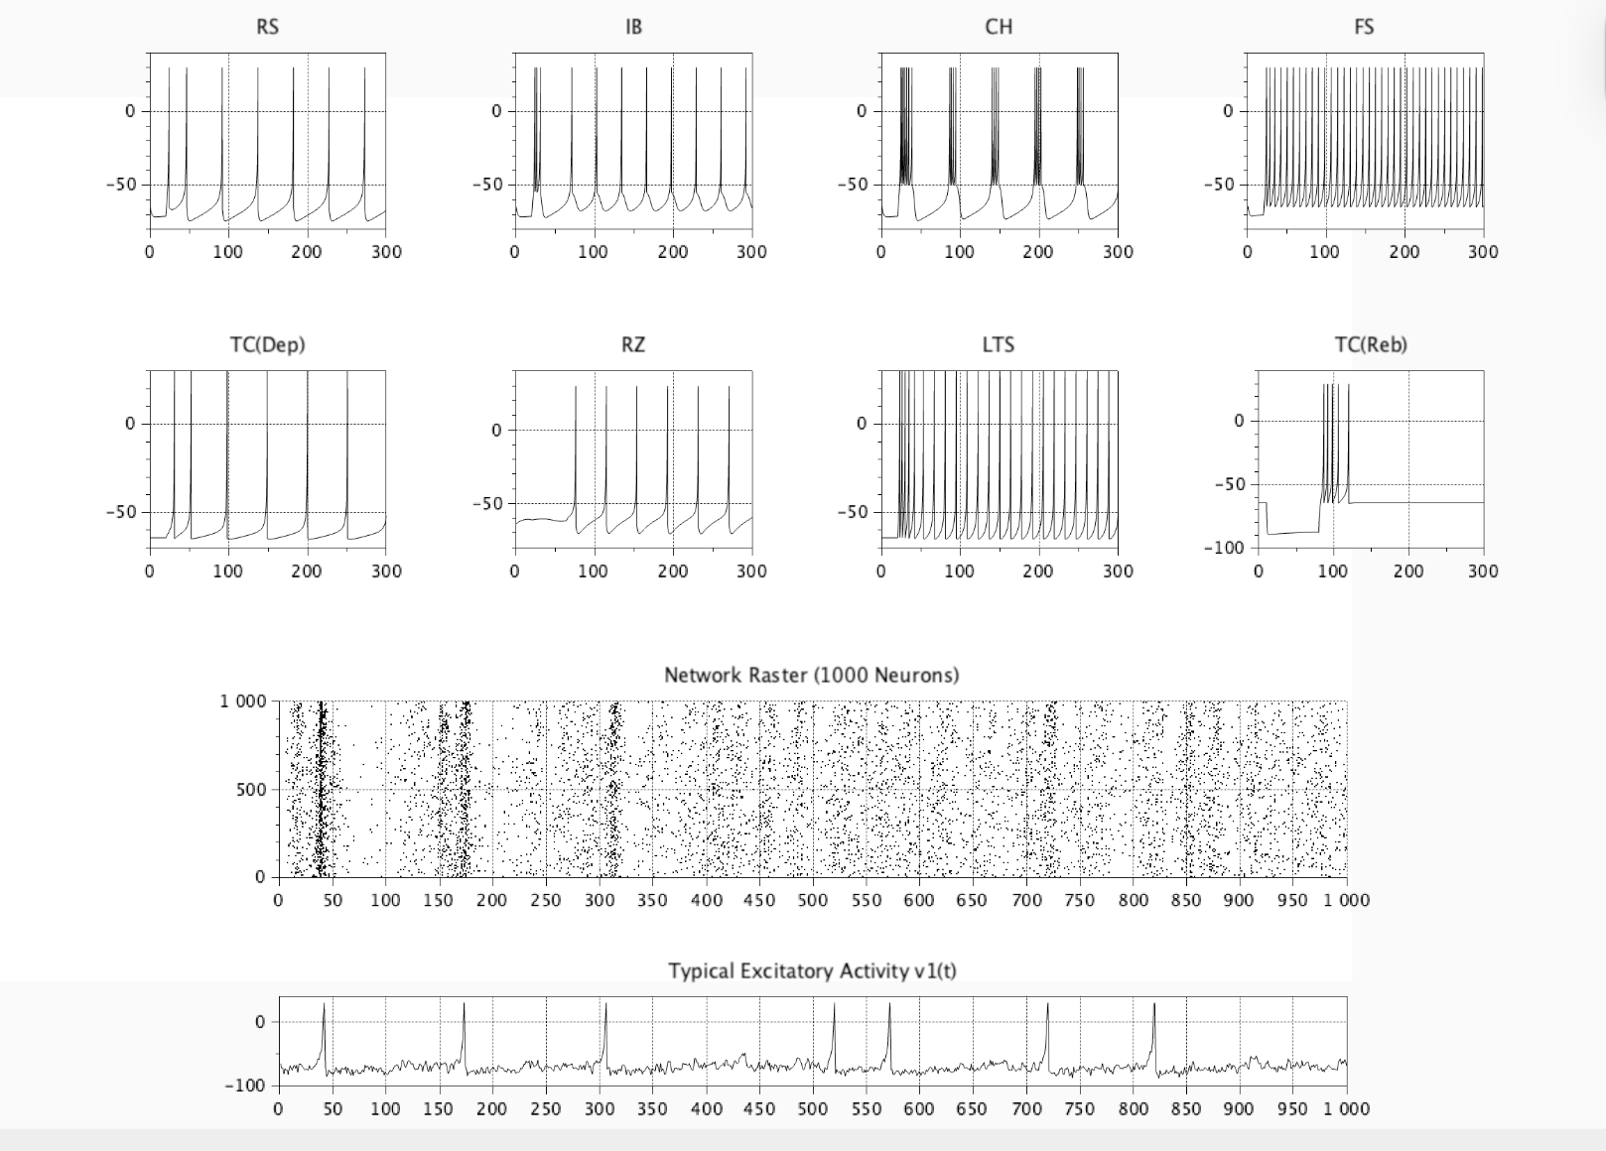
Interactive GUI Dashboard
Real-Time Tuning
Developed a comprehensive dashboard to explore the four-parameter space (a, b, c, d) of the model.
•
Live Feedback: Dynamic equation substitution in axis titles.
•
Protocol Selection: Instant switching between RS, IB, CH, FS, and Resonator modes.
•
Stability: Robust handle management prevents Scilab UI crashes.

Slide 10






Large-Scale Cortical Dynamics
1,000 Neurons
Brain Rhythms
Split-Step Euler
Dense matrix simulation with 800 excitatory and 200 inhibitory cells.
Reproduction of Alpha (10Hz) and Gamma (40Hz) vertical bands.
0.5ms half-step dual integration ensured mathematical stability at 1ms resolution.

Slide 11

Conclusions & Impact
Real-World Physics: Proved Scilab's capability to model stiff ODEs in biological timescales.
Zero-Toolbox Dependency: All logic implemented via base mathematical integration.
FOSS Advantage: Provided a high-fidelity alternative to proprietary neuroscience simulators.
Scalability: Successfully demonstrated self-organization in massive pulse-coupled networks.

Slide 12
Thank You
Sumat Dhuwariya
Department of Computer Science, VIT Bhopal
FOSSEE Summer Fellowship 2026 | IIT Bombay

