Slide 1
FOSSEE Summer Fellowship Report
SCILAB CASE STUDIES
Sanyam Bhavsar
Int. M.Tech Student, Data Science and Computation, VIT Bhopal University
Guide: Prof. Prabhu Ramachandran, IIT Bombay | Mentor: Rashmi Patankar
July 2026

Slide 2


Case Study 1: Smart Irrigation System
Objective: Develop a Scilab-based system using soil moisture, temperature, and humidity sensors to automate irrigation decisions.
Key Features:
  Simulates real-time sensor data
  Redundant sensors for fault tolerance
  Fault detection via range checks, sudden-jump detection, and residual analysis
  Corrected data drives intelligent irrigation control logic
  Automated irrigation ON/OFF based on threshold (40%)

Slide 3
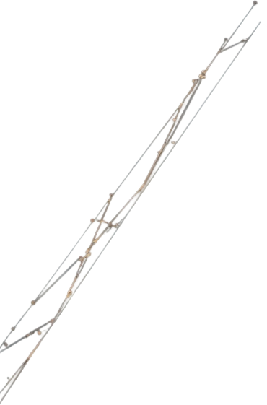
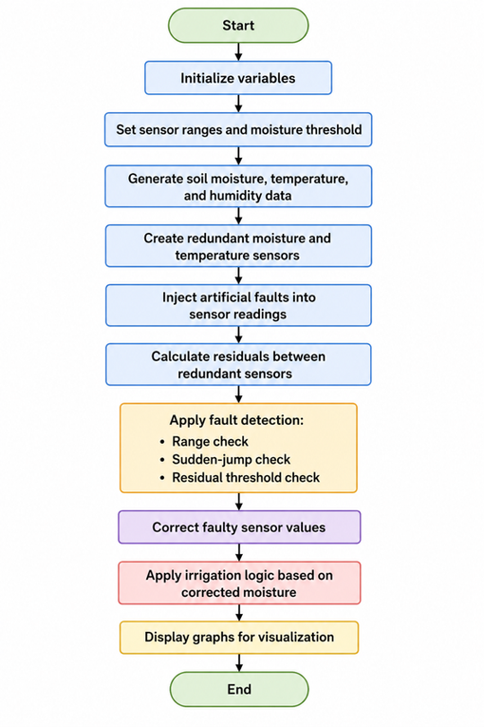

Problem Statement & Flowchart
Objectives
Flowchart
  1. Simulate soil moisture, temperature, and humidity data in Scilab
  2. Create redundant sensor readings for soil moisture and temperature
  3. Inject artificial faults into sensor data
  Detect faults using:
  Range check
  Sudden-jump check
  Residual-based check
  4. Correct faulty values before irrigation decision-making
  5. Decide irrigation ON/OFF using corrected soil moisture
  6. Show system behavior using Scilab graphs

Slide 4


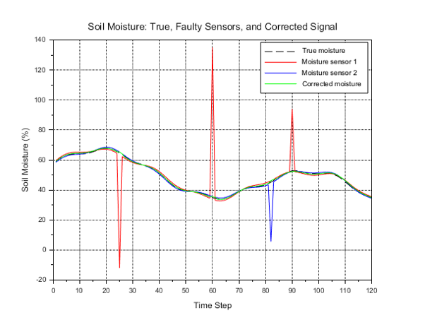

Results: Soil Moisture & Residual
Soil moisture sensor readings over time — corrected vs. raw values
Observation: Corrected soil moisture is more reliable. Residual crosses threshold when fault is detected.

Slide 5
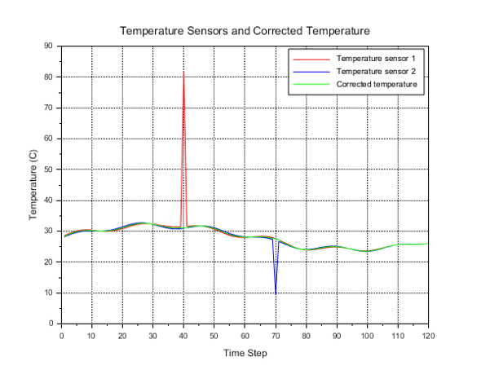
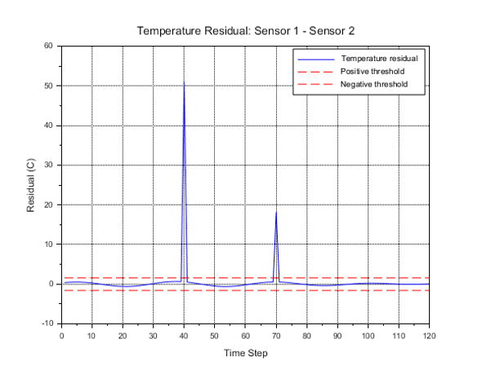
Temperature Graph
Temperature Residual Graph

Slide 6
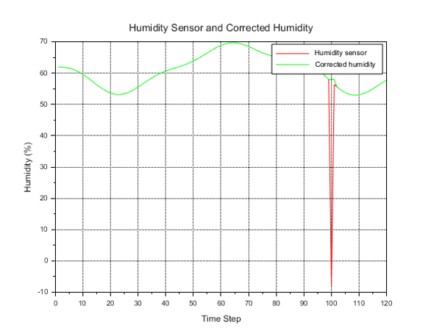
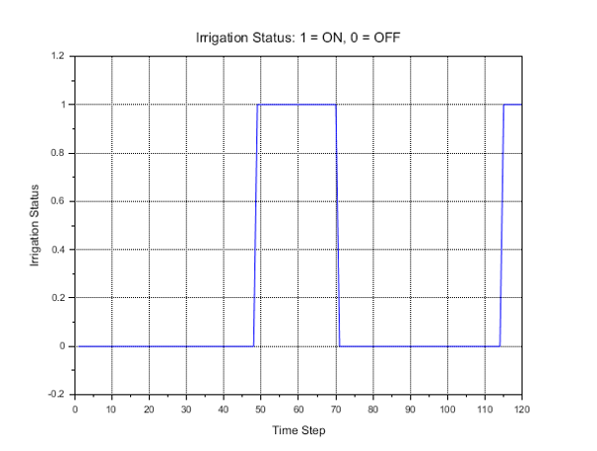
Humidity Graph
Irrigation Status Graph

Slide 7
Result Comparison with Reference Papers
Parameter | Expected from Research Paper | Observed in Scilab Simulation
Irrigation Control | Pump ON when soil moisture is low | Pump status = 1 when moisture < 40%
Sensor Monitoring | Monitor moisture, temperature, and humidity | Simulated sensor data generated successfully
Redundant Sensors | Two sensors for each measured quantity | Two moisture sensors and two temperature sensors implemented
Residual Detection | Fault detected when residual exceeds threshold | Fault triggered when residual crosses predefined threshold
Implementation | Hardware/Laboratory setup | Complete software-based simulation in Scilab

Slide 8

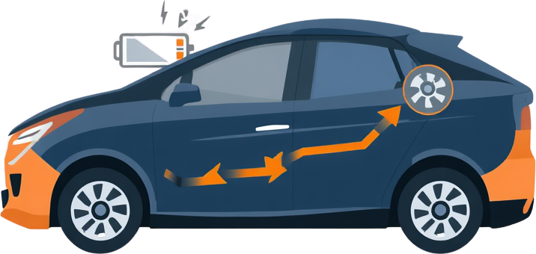

Case Study 2: Regenerative Braking Control
Objective: Design and simulate a regenerative braking system for electric vehicles using Scilab/Xcos, enabling energy recovery during deceleration.
Controllers Compared:
  PI Controller: Classic proportional-integral control
  Sliding Mode Controller (SMC): Robust nonlinear control
Key Highlights:
  Xcos block diagrams model EV drivetrain and braking dynamics
  Boost converter modeled for energy recovery circuit
  SMC offers superior disturbance rejection and faster settling time
  Metrics: speed, distance, current, and energy recovery

Slide 9

Problem Statement
The Challenge:
  Conventional braking systems waste kinetic energy as heat during deceleration
The Solution:
  Regenerative braking converts kinetic energy to electrical energy
  Stores energy back in battery
  During braking, motor acts as a generator
  Back EMF drives current through boost converter
Objectives:
  Regenerative current control
  Converter duty-cycle regulation
  Battery charging performance
  Recovered energy analysis
  Vehicle braking response

Slide 10
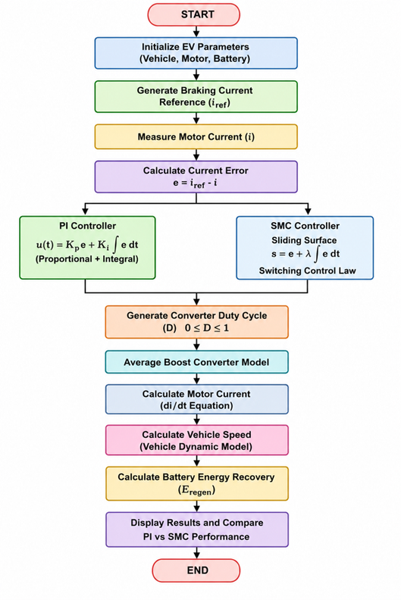
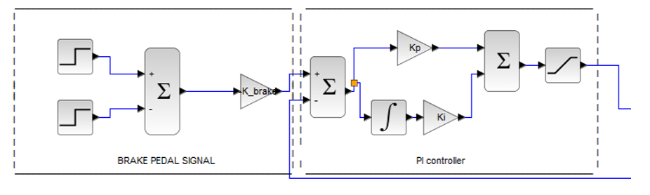
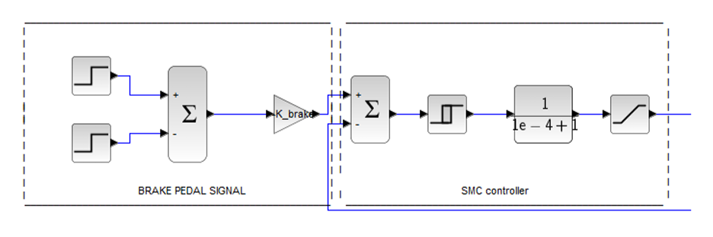
Flowchart & Xcos Models
  PI Controller Model
  Step-by-step control logic from vehicle deceleration through energy recovery
  SMC Controller Model

Slide 11
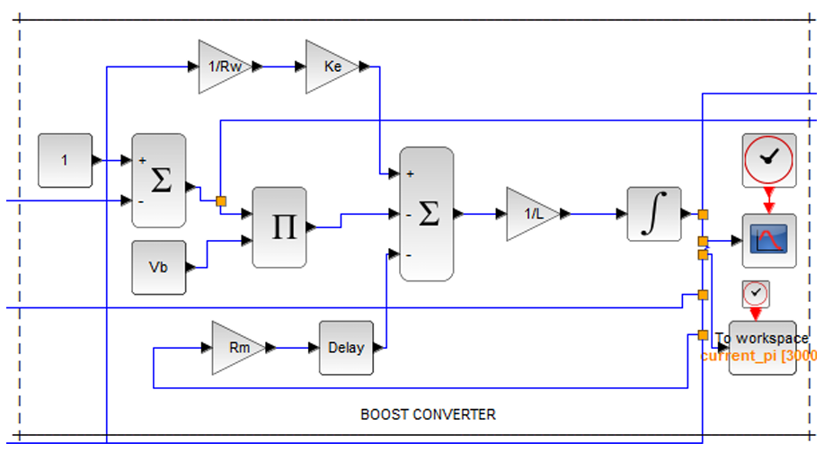
Flowchart & Xcos Models
  Boost Converter Model

Slide 12


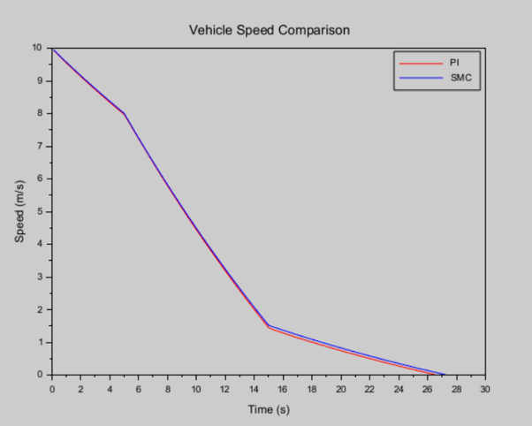
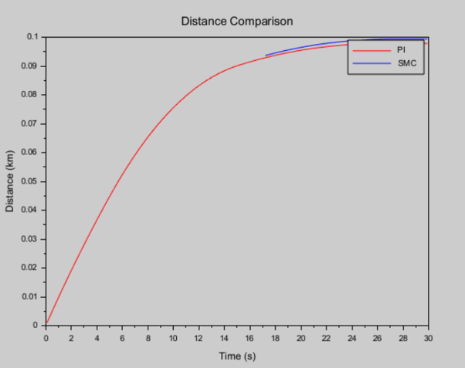

Results: Speed, Distance & Current
Speed Comparison:
  SMC provides smoother speed regulation with reduced oscillations
  Indicates better current tracking and efficient energy conversion
Distance Comparison:
  SMC achieved approximately 1.56% more distance

Slide 13
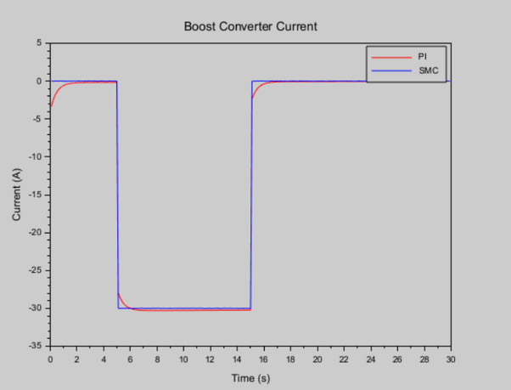
Results: Speed, Distance & Current
Current Response:
  PI: 7% undershoot at brake start, 8% overshoot at brake end
  SMC: <2% overshoot, reaches target in ~40ms
  SMC ripple: only ±0.02A

Slide 14
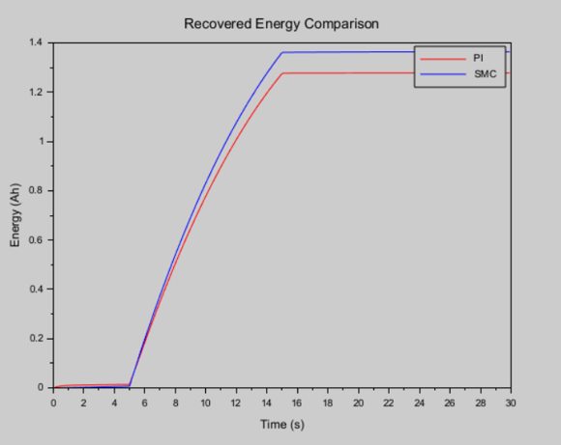
Energy Recovery & Performance Summary
Performance Summary
Energy Recovery Graph:
  SMC recovers 6.76% more energy per braking event
  PI loses energy due to:
    1.5s settling window at brake start
    1.0s windup discharge at brake end
    ±0.8A steady-state ripple
Energy Recovery Graph

Slide 15
Performance Summary Table
Parameter | PI | SMC | Improvement
Total Distance | 0.0978 km | 0.0993 km | 1.56%
Recovered Energy | 1.2775 Wh | 1.3639 Wh | 6.76%
Settling Time | 1.5 s | 0.04 s | SMC faster
Current Undershoot | 7% | <2% | SMC better
Current Ripple | ±0.8 A | ±0.02 A | SMC better

Slide 16
Case Study 3: PCA-Based Facial Recognition
Objective: Implement the Eigenfaces algorithm using Principal Component Analysis (PCA) in Scilab for automated facial recognition.
Dataset: AT&T ORL Face Database
  400 images across 40 subjects
  Training: 320 images (first 8 per person)
  Testing: 80 images (remaining 2 per person)
Method:
  Each face compressed from 10,304 pixels to just 50 Eigenface weights
  Dimensionality reduction enables fast, accurate recognition
Key Highlights:
PCA extracts most discriminative facial features (Eigenfaces)
Recognition via Euclidean distance in reduced feature space
Custom GUI for training, testing, and reconstruction

Slide 17
Problem Statement
The Challenge:
  Single image = 112 × 92 = 10,304 pixels
  Pixel-by-pixel comparison requires too much computation and memory
  Variations in lighting, expressions, hairstyle, and image quality cause inaccuracies
The Solution:
  Principal Component Analysis (PCA) reduces dimensionality while retaining essential facial information
  Each face represented by only 50 weights instead of 10,304 pixels
  "Eigenfaces" = Principal components of face images

Slide 18

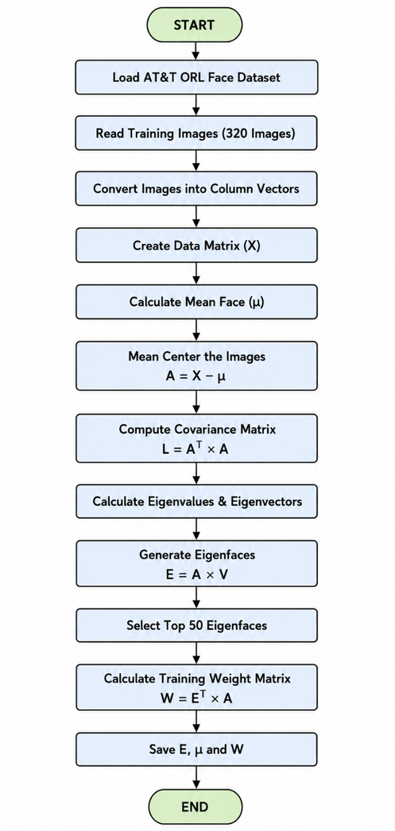
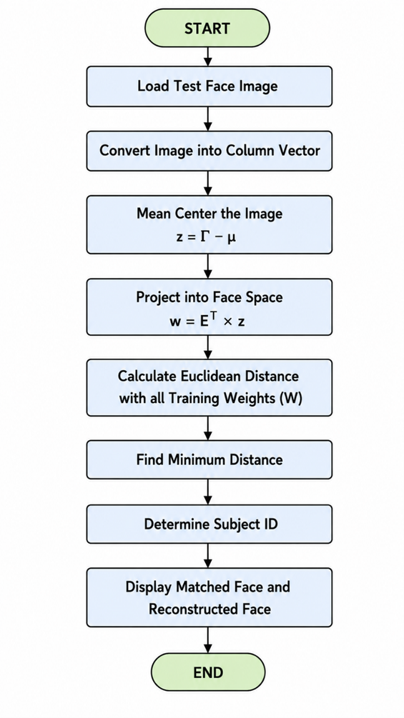


Flowcharts
Training Phase Flowchart
Recognition Phase Flowchart

Slide 19

GUI Overview
GUI Features:
Custom GUI developed natively in Scilab
Buttons:
Train Model — Loads 320 images, computes eigenfaces
Upload Test Image — Select image from test set
Recognize Face — Projects and finds closest match
Reconstruct Face — Rebuilds face from eigenface weights
Test Accuracy — Evaluates on all 80 test images
Display Panels:
Test Image (left)
Matched Face (center)
Reconstruction (right)

Slide 20


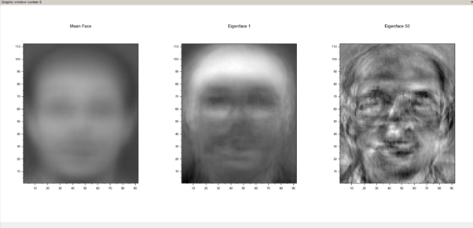

Training Results
Mean Face:
Blurred average of all training images
Contains only common facial features
Eigenfaces:
"Ghost-like" patterns encoding facial variations
1st Eigenface: Overall transformations (face width, structure)
Higher Eigenfaces: More specific details (contours, textures)

Slide 21
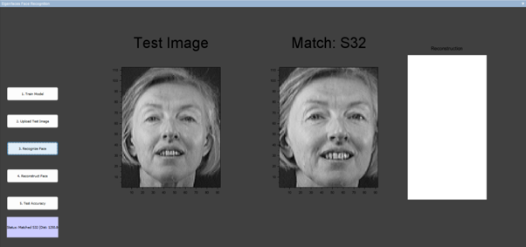
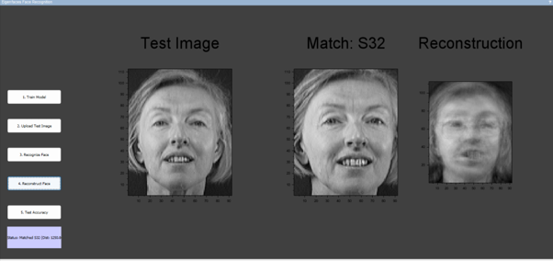
Recognition & Reconstruction Results
Recognition Result
Reconstruction

Slide 22
Accuracy Summary
Parameter | Result
Training Images | 320
Test Images | 80
Number of Subjects | 40
Selected Eigenfaces | 50
Recognition Method | Euclidean Distance
Recognition Accuracy | 95%
  95% accuracy achieved using only 50 Eigenface weights
  Dimensionality reduction: 10,304 → 50 features

Slide 23




Conclusion
  Successfully implemented three diverse case studies using Scilab
  Demonstrated Scilab's versatility across:
Agriculture (Smart Irrigation)
Automotive (Regenerative Braking)
Image Processing (Facial Recognition)
3. Open-source tools like Scilab bridge the gap between theory and practice in engineering education
4. Reduced dependency on proprietary software while maintaining high-quality results

Slide 24
Key Learnings
  Practical experience with Scilab and Xcos
  Control system design and implementation
  Sensor fault detection and data validation
  Principal Component Analysis for dimensionality reduction
  GUI development for user-friendly interfaces
  Importance of open-source software in engineering education
  PCA for dimensionality reduction

Slide 25
References
1. Automatic Irrigation System using Soil Moisture Sensor
https://www.researchgate.net/publication/362701179_Automatic_Irrigation_System_using_Soil_Moisture_Sensor
2. Sensor Fault Detection and Isolation for Smart Irrigation using Parity Space Approach
https://pdfs.semanticscholar.org/240a/bf4b9733b62074dd2a54bcbcb89190f7a179.pdf
3. Energy-Regenerative Braking Control of Electric Vehicles Using Three-Phase BLDC Motors (MDPI, 2014)
https://www.mdpi.com/1996-1073/7/1/99
4. Eigenfaces for Recognition — Matthew Turk and Alex Pentland
https://www.face-rec.org/algorithms/PCA/jcn.pdf
5. Scilab - An Open Source Software
https://www.scilab.in/
6. FOSSEE Project, IIT Bombay
https://fossee.in/

Slide 26
Thank You
fossee.in | IIT Bombay

