Slide 1


FOSSEE SUMMER FELLOWSHIP · PROGRESS PRESENTATION
Scilab Image Processing
Toolbox Development
Line-by-line translation of GNU Octave Image Processing functions into native, validated Scilab code
PRESENTER
MENTOR
GUIDE
Sanika Wagle
Mrs. Rashmi Patankar
Prof. Prabhu Ramachandran
FOSSEE · IIT Bombay | Scilab Image Processing Toolbox
1

Slide 2




INTRODUCTION
Project Overview
CORE MOTIVATION
The objective of this project is to develop native Scilab implementations of Image Processing Toolbox functions by translating and optimizing their GNU Octave equivalents.
The fellowship focuses on preserving Octave compatibility while adapting algorithms to Scilab's architecture and programming model — porting each function close to line-by-line, reconstructing dependencies where Scilab lacks a direct equivalent.
Expand Scilab's open-source image-processing capability
Preserve line-by-line fidelity with Octave source functions
Reconstruct missing dependency functions natively in Scilab
Ensure reproducible, numerically validated outputs
17
4
Functions Ported
Dependency Functions Built
FOSSEE · IIT Bombay | Scilab Image Processing Toolbox
2

Slide 3


INTRODUCTION
Objectives
MAIN GOAL
SUPPORTING OBJECTIVES
Convert Octave Image Processing functions to Scilab with near line-by-line translation of code and structure.
Reconstruct missing dependency functions using Scilab's native machinery.
Verify numerical equivalence between Octave source output and the Scilab port through systematic test cases.
Build a coherent, interoperable set of functions where ported pieces correctly depend on one another.
Document each function's behaviour and edge cases for future contributors to the Scilab IPT.
FOSSEE · IIT Bombay | Scilab Image Processing Toolbox
3

Slide 4

METHODOLOGY
Development Workflow
Each of the 17 functions follows this disciplined four-stage pipeline. Cross-validation against Octave output is the final gate before a function is marked complete.
01
02
03
04
›
›
›
Read Octave Source
Translate to Scilab
Build Dependencies
Test & Validate
Study the .m implementation, signature, and edge-case handling.
Port syntax and control flow, adapting to Scilab's language model.
Implement helper/dependency functions natively where none exist.
Run identical test cases in both tools and compare numerical output.
FOSSEE · IIT Bombay | Scilab Image Processing Toolbox
4

Slide 5
FUNCTIONS IMPLEMENTED · GROUP 1 OF 3
Image Quality & Analysis
Function | What It Does | Depends On
histeq | Enhances image contrast via histogram equalization. | —
immse | Computes the mean-squared error between two images. | —
psnr | Computes peak signal-to-noise ratio between two images. | immse
stretchlim | Finds intensity limits for contrast-stretching an image. | postpad
graythresh | Computes a global threshold using Otsu's method. | intmax
bwarea | Estimates the area of foreground objects in a binary image. | —
FOSSEE · IIT Bombay | Scilab Image Processing Toolbox
5

Slide 6
FUNCTIONS IMPLEMENTED · GROUP 2 OF 3
Geometric & Structural Operations
Function | What It Does | Depends On
padarray | Pads an image/array with a specified value or method. | —
qtdecomp | Performs quadtree decomposition of an image. | —
qtgetblk | Retrieves blocks of a given size from a quadtree decomposition. | qtdecomp
qtsetblk | Sets the values of blocks within a quadtree decomposition. | qtdecomp
normxcorr2 | Computes normalized 2-D cross-correlation of two images. | postpad
phantom | Generates the Shepp–Logan phantom test image. | —
FOSSEE · IIT Bombay | Scilab Image Processing Toolbox
6

Slide 7
FUNCTIONS IMPLEMENTED · GROUP 3 OF 3
Color Space & Data-Type Conversion
Function | What It Does | Depends On
lab2uint8 | Converts an L*a*b* image to uint8 representation. | lab2cls
lab2uint16 | Converts an L*a*b* image to uint16 representation. | lab2cls
lab2double | Converts an L*a*b* image to double-precision representation. | lab2cls
lab2single | Converts an L*a*b* image to single-precision representation. | lab2cls
getrangefromclass | Returns the display range for an image's numeric class. | intmin, intmax
All 17 functions validated against Octave reference output with matching test cases.
FOSSEE · IIT Bombay | Scilab Image Processing Toolbox
7

Slide 8
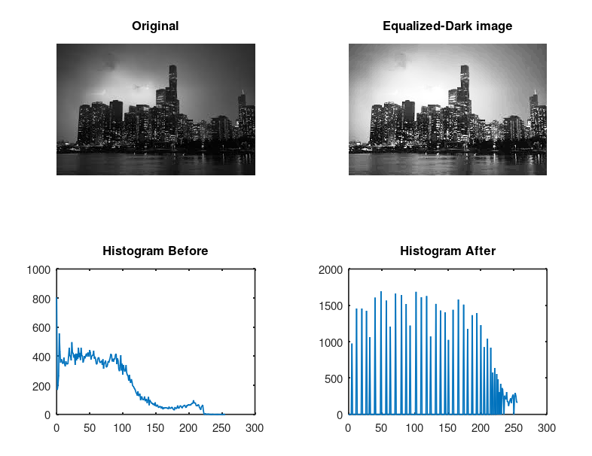
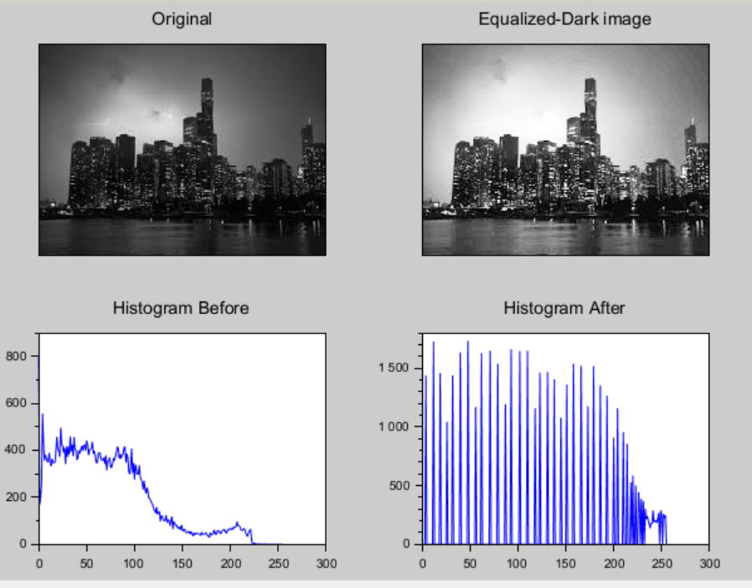
Demonstration — Test Cases
Octave
Scilab
1 · histeq — contrast enhancement
I = imread(“dark_image.jpg");
J = histeq(I);
imshow(I);
Imshow(J);
Calling Sequence:
equi_hist = histeq(Img)
equi_hist = histeq(Img, numBins)
Parameters
Img (Matrix): Input grayscale or RGB image.
numBins (Integer, Optional): Number of histogram bins used for equalization. Default value: 64.
equi_hist (Matrix): Output histogram-equalized image with intensity values in the range [0, 1].
FOSSEE · IIT Bombay | Scilab Image Processing Toolbox
8
Notes:
Run these three functions live: histeq, immse/psnr, bwarea. Have both Octave and Scilab open. Paste code from this slide (or a prepared script) into each console and compare outputs side by side. Swap the mock console text for real captured screenshots before the actual presentation.

Slide 9
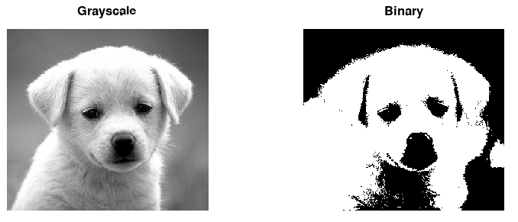
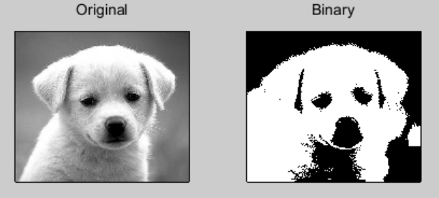
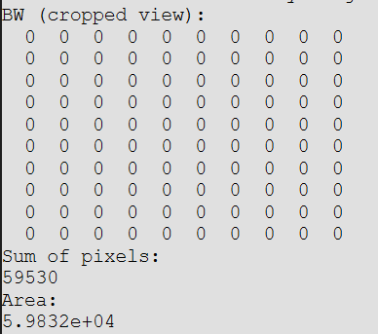
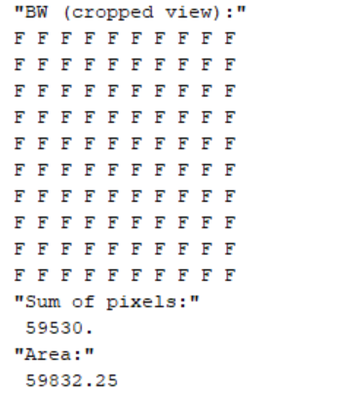
Octave
Scilab
2 · bwarea — binary object area
grayImg = rgb2gray(Img);
BW = grayImg > 128;
area = bwarea(BW);
Imshow(BW);
Calling Sequence:
area = bwarea(BW)
Parameters
BW (Matrix): Input 2-D binary image.
area (Double): Output estimated area of all foreground objects in the binary image. The result may be a non-integer value.

Slide 10
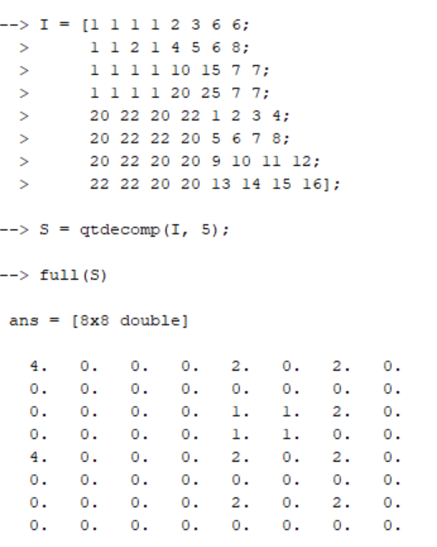
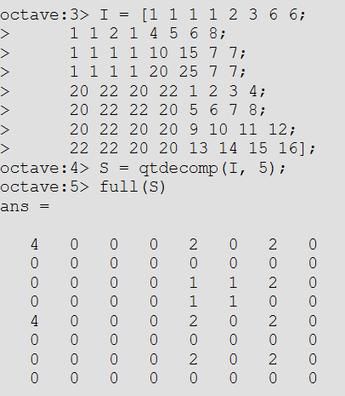
QTDECOMP · QTGETBLK · QTSETBLK
OCTAVE vs. SCILAB — qtdecomp test matrix (8×8)
Function Deep Dive — Quadtree Family
I = [1 1 1 1 2 3 6 6;
1 1 2 1 4 5 6 8;
1 1 1 1 10 15 7 7;
1 1 1 1 20 25 7 7;
20 22 20 22 1 2 3 4;
20 22 22 20 5 6 7 8;
20 22 20 20 9 10 11 12;
22 22 20 20 13 14 15 16];
S = qtdecomp(I, 5);
full(S)
qtdecomp splits an image into homogeneous square blocks, recursively subdividing regions whose intensity variation exceeds a threshold — the classic quadtree decomposition used in compression and region analysis.
qtgetblk retrieves all blocks of a chosen size from that decomposition; qtsetblk writes new values back into blocks of a chosen size, making the trio a complete read-decompose-modify cycle.
Calling Sequence:
S = qtdecomp(I)
S = qtdecomp(I, threshold)
S = qtdecomp(I, threshold, mindim)
S = qtdecomp(I, threshold, [mindim maxdim])
S = qtdecomp(I, fun)
S = qtdecomp(I, fun, ...)
Scilab
Octave
Parameters
I (Matrix): Input grayscale image.
threshold / fun (Optional): Block splitting criterion.
mindim / maxdim (Optional): Minimum and maximum block sizes.
S (Matrix): Quadtree decomposition matrix.
FOSSEE · IIT Bombay | Scilab Image Processing Toolbox
9
Notes:
Replace the code panel with an actual side-by-side screenshot of Octave and Scilab output for qtdecomp on this test matrix. Threshold 5 is used as a simple illustrative example.

Slide 11



COLOR SPACE, CLASS RANGE & QUALITY METRICS
Function Deep Dive — Dependency Chains
Several ported functions rely on smaller dependency functions that Scilab lacked natively. These were implemented first, then reused across the toolbox — mirroring Octave's own internal structure.
lab2cls
intmin / intmax
postpad
immse
used by:
used by:
used by:
used by:
used by:
getrangefromclass
graythresh
stretchlim
normxcorr2
psnr
lab2uint8
lab2uint16
lab2double
lab2single
FOSSEE · IIT Bombay | Scilab Image Processing Toolbox
10

Slide 12






Challenges & Key Learnings
Bridging Argument & Type Semantics
Rebuilding Foundational Utilities
Octave's nargin/varargin and dynamic typing needed manual reconstruction using Scilab's argn(2) and typeof() checks — especially for functions with optional arguments and multiple return values.
Several ported functions depended on infrastructure Scilab lacks natively (postpad, lab2cls, intmin, intmax) — each had to be implemented and independently validated before its parent function could even be tested.
Sparse-Matrix & Indexing Differences
Precision-Safe Type Conversion
qtdecomp's block-size output relies on sparse-matrix semantics that differ between the two tools, so the recursive splitting logic had to be rebuilt around Scilab's sparse() construction and indexing rules.
Octave and Scilab handle uint8/uint16/double image data differently; lab2uint8, lab2uint16 and getrangefromclass needed explicit rounding and clipping logic to avoid silent precision loss.
Numerical-Equivalence Testing Discipline
Deeper Algorithmic Understanding
Every function was validated with identical test images and matrices in both tools, and considered complete only once outputs matched Octave to floating-point precision.
Porting quadtree decomposition and Otsu's method line-by-line meant understanding the underlying mathematics, not just translating syntax from Octave
FOSSEE · IIT Bombay | Scilab Image Processing Toolbox
11

Slide 13

Future Scope & Conclusion
SUGGESTED FUTURE DEVELOPMENT
Algorithmic Expansion: Extend the toolbox to support advanced domains such as 3D image processing, computer vision routines, and deep learning-based segmentation.
Code Optimization & Acceleration: Leverage Scilab API gateways to rewrite execution-heavy loops in C/C++, or introduce GPU/multithreading support for processing large-scale image datasets.
Low-Code & Graphical Integration: Develop native Xcos blocks or standalone interactive GUIs for these functions, enabling visual, drag-and-drop workflow design for researchers.
FOSSEE · IIT Bombay | Scilab Image Processing Toolbox
12

Slide 14
Thank You
12

