Slide 1


Scilab
Control System
Toolbox
Samiksha S
BSc Data Science Mount Carmel College, Bengaluru, Karnataka
GUIDE :
Prof. Prabhu Ramachandran, IIT BOMBAY
MENTOR :
Rashmi Patankar

Slide 2
Overview
INTRODUCTION
This project involves translating control-system functions from GNU Octave into Scilab, producing faithful, working equivalents.
The goal is a Scilab library that mirrors Octave's LTI Syncope and control toolbox behavior. It should be covering state-space and transfer-function models, and control (Riccati-based).
Each function is ported close to line-by-line, with dependencies reconstructed where Scilab lacks a direct equivalent, and validated against Octave's numerical output.

Slide 3
Overview
INTRODUCTION
This project involves translating control-system functions from GNU Octave into Scilab, producing faithful, working equivalents.
The goal is a Scilab library that mirrors Octave's LTI Syncope and control toolbox behavior. It should be covering state-space and transfer-function models, and control (Riccati-based).
Each function is ported close to line-by-line, with dependencies reconstructed where Scilab lacks a direct equivalent, and validated against Octave's numerical output.

Slide 4

Objective
INTRODUCTION
Main Goal
Convert Octave control functions to Scilab with near 1:1 translation of the code and structure.
Reconstruct missing dependencies (SLICOT-style solvers, helper routines) using Scilab's native machinery.
Supporting Objectives
Verify numerical equivalence between the Octave source and the Scilab port through systematic test cases.
Build a coherent, interoperable set of functions where ported pieces correctly depend on one another.

Slide 5
What I Learned
INTRODUCTION
Translating between Octave and Scilab required understanding where the two diverge structurally: argn(2) for argument counts instead of nargin
select/case for switch
explicit for loops in place of cellfun
Octave relies on compiled SLICOT routines (e.g.SB02OD, SG02AD) that don't exist in Scilab. I learned to reconstruct these numerically
For example, computing Riccati solutions via the ordered Schur decomposition of an extended symplectic pencil.
It was quite hard to be able to do this as it led to a FORTRAN routine.
This meant understanding the mathematics behind the function instead of directly finding equivalents in scilab.
It was quite satisfying to find the SLICOT routines that i have implemented in Scilab to be giving the exact outputs as octave.

Slide 6


FUNCTIONS
DARE CARE DLQR DLQE LQR LQE
CTRBF
OBSVF DSS
VERTCAT @ lt i HORZCAT @ lt i MINUS @ lt i
PLUS @ lt i
WESTLANDLYNX FILTDATA

Slide 7
Riccati Equation
The Riccati equation is a matrix equation that appears in optimal control and estimation problems. It is fundamental to the design of controllers such as the Linear Quadratic Regulator (LQR) and observers such as the Kalman Filter.
For continuous-time systems, the Algebraic Riccati Equation (CARE) is
For discrete-time systems, the Discrete Algebraic Riccati Equation (DARE) is
Computes the optimal state-feedback gain.
Minimizes a quadratic cost function balancing state error and control effort. Ensures closed-loop stability for controllable systems.
Applications
Kalman Filtering & Sensor Fusion : The Riccati equation is solved repeatedly to optimally combine noisy measurements from sensors such as GPS, IMUs, LiDAR, and cameras.
Robotics : Controls robotic arms, humanoid robots, and drones for smooth and energy-efficient motion.

Slide 8
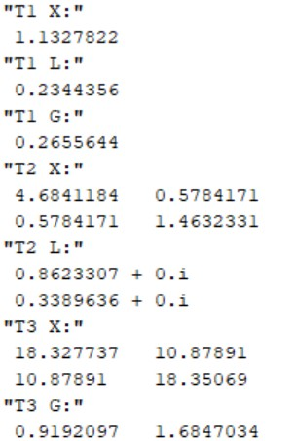
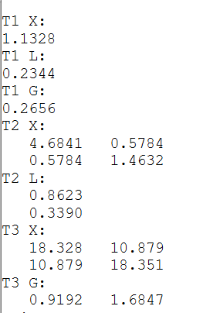
DARE
Solves the discrete-time algebraic Riccati equation, returning the riccati solution, closed-loop poles, and gain. Ported using a custom sl_sb02od and sl_sg02ad solver built on the ordered Schur decomposition of an extended symplectic pencil.
Scilab Octave
Input:
A, B, Q, R[, S[, E]]
Output:
X (Riccati solution),
L (closed-loop poles),
G (optimal state-feedback gain)
Dependencies:
__sl_sb02od__, __sl_sg02ad__
Parameters:
A – State matrix
B – Input matrix
Q – State weighting matrix
R – Input weighting matrix
S – Cross-weighting matrix (optional)
E – Descriptor matrix (optional)

Slide 9
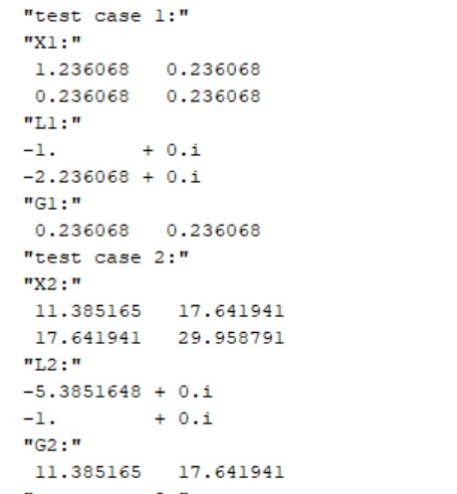
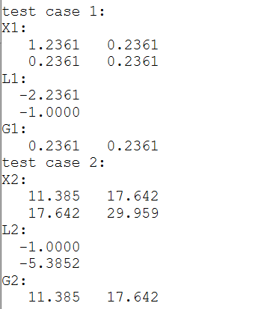
CARE
Solves the continuous-time algebraic Riccati equation. Shares the same sl_sb02od / sl_sg02ad
Schur-based helpers as dare, differing only in the pencil form and gain formula. Similarly returns riccati solution, closed-loop poles, and gain.
Scilab Octave
Input:
A, B, Q, R[, S[, E]]
Output:
X (Riccati solution)
L (closed-loop poles)
G (optimal state-feedback gain)
Dependencies:
__sl_sb02od__, __sl_sg02ad__
Parameters:
A – State matrix
B – Input matrix
Q – State weighting matrix
R – Input weighting matrix
S – Cross-weighting matrix (optional)
E – Descriptor matrix (optional)

Slide 10
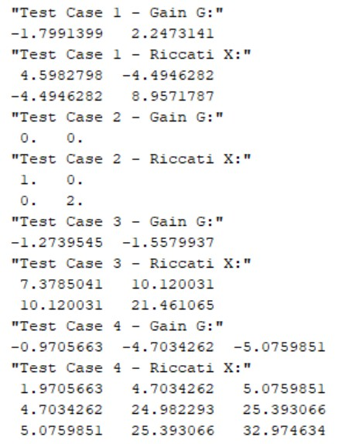
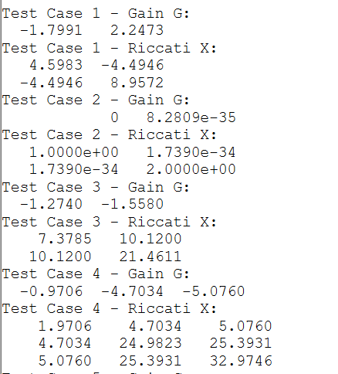
DLQR
Designs the discrete-time linear-quadratic regulator, returning the optimal state-feedback gain.
Depends on dare and care according to if the embedded system is continuous or not, dssdata, and issample.
Scilab
Octave
Input:
A, B, Q, R[, S[, E]] or sys, Q, R[, S]
Output:
G (optimal gain),
X (Riccati solution)
L (closed-loop poles)
Dependencies:
dare, care, dssdata, issample
Parameters:
A/sys – State-space system B – Input matrix
Q – State weighting matrix
R – Input weighting matrix
S – Cross-weighting matrix (optional)
E – Descriptor matrix (optional)

Slide 11
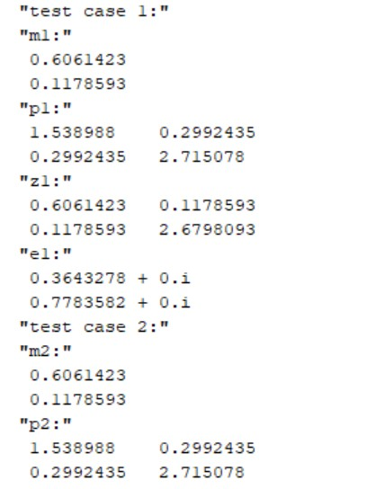
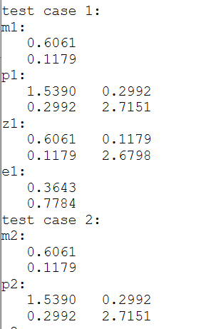
DLQE
Designs the discrete-time linear-quadratic estimator gain and error covariance. Depends on dare, using the dual formulation on the transposed system.
Scilab
Octave
Input:
A, G, C, Q, R[, S] or sys, Q, R[, S]
Output:
M (Kalman gain)
P (error covariance), Z (Riccati solution) E (estimator poles)
Dependencies:
dare Parameters:
A – State matrix
G – Process noise matrix C – Output matrix
Q – Process noise covariance
R – Measurement noise covariance
S – Cross-covariance matrix (optional)

Slide 12
LQR
Continuous-time counterpart of dlqr; computes the optimal LQ regulator gain.
Depends on dare and care according to if the embedded system is continuous or not, dssdata, and issample.
Scilab
Octave
Input:
A, B, Q, R[, S[, E]] or sys, Q, R[, S]
Output:
G (optimal gain)
X (Riccati solution)
L (closed-loop poles)
Dependencies:
care, dare, dssdata, issample
Parameters:
A/sys – State-space system B – Input matrix
Q – State weighting matrix
R – Input weighting matrix
S – Cross-weighting matrix (optional)
E – Descriptor matrix (optional)

Slide 13
LQE
Continuous-time counterpart of dlqr; computes the optimal LQ regulator gain.
Depends on dare and care according to if the embedded system is continuous or not, dssdata, and issample.
Scilab
Octave
Input:
A, G, C, Q, R[, S] or sys, Q, R[, S]
Output:
L (Kalman gain)
P (error covariance) E (estimator poles)
Dependencies:
lqr, care, dare
Parameters:
A – State matrix
G – Process noise matrix C – Output matrix
Q – Process noise covariance
R – Measurement noise covariance
S – Cross-covariance matrix (optional)

Slide 14
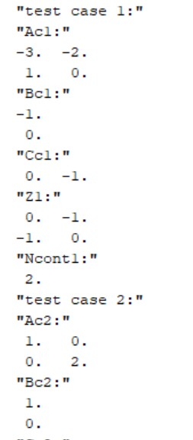
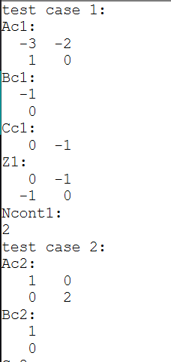
CTRBF
Computes the controllability staircase (Kalman controllable) decomposition of a state-space system, separating controllable and uncontrollable state subspaces using an orthogonal similarity transformation. Returns the transformed state-space matrices Ac, Bc, Cc, the orthogonal transformation matrix Z, and the number of controllable states ncont. Depends on the custom sl_tb01ud routine.
Scilab Octave
Input:
A, B, C[, tol] or sys[, tol] Output:
Ac, Bc, Cc (transformed system) Z (orthogonal transformation)
ncont (number of controllable states)
Dependencies:
__sl_tb01ud__, ssdata
Parameters:
A – State matrix
B – Input matrix
C – Output matrix
sys – State-space system
tol – Rank tolerance (optional)

Slide 15
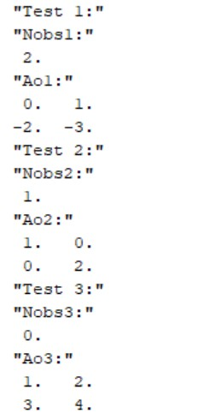
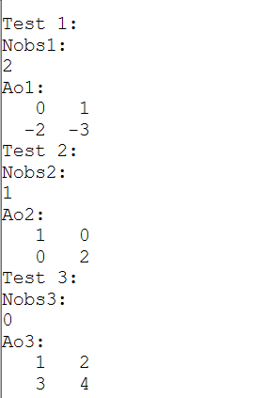
OBSVF
Computes the observability staircase decomposition (Kalman observable) of a state-space system, separating observable and unobservable state subspaces using an orthogonal similarity transformation.
Returns the transformed state-space matrices, the orthogonal transformation matrix Z, and the number of observable states nobs. Depends on the ctrbf function.
Scilab Octave
Input:
A, B, C[, tol] or sys[, tol] Output:
Ao, Bo, Co (transformed system) Z (orthogonal transformation)
nobs (number of observable states)
Dependencies:
ctrbf, ssdata
Parameters:
A – State matrix
B – Input matrix
C – Output matrix
sys – State-space system
tol – Rank tolerance (optional)

Slide 16
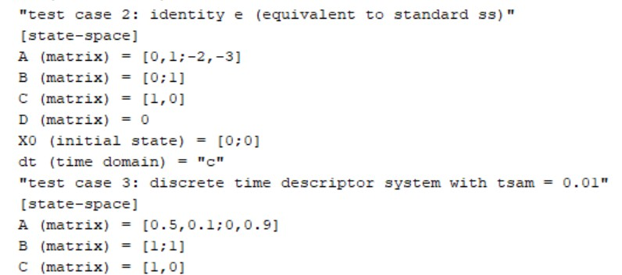
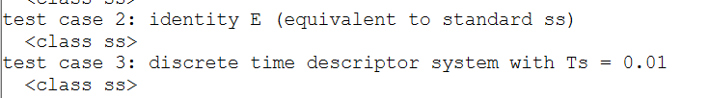
DSS
dss creates a descriptor (generalized state-space) model of a linear time-invariant (LTI) system. It represents systems of the form Ex˙=Ax+Bu, y=Cx+Du allowing the descriptor matrix E to be specified explicitly. It supports both continuous-time and discrete-time descriptor systems.
Scilab
Input:
A, B, C, D, E, tsam (optional)
Output:
sys – Descriptor state-space (dss) LTI system.
Dependencies:
__sys_data__
Parameters:
A – State matrix.
B – Input matrix.
C – Output matrix.
D – Feedthrough matrix.
E – Descriptor matrix. tsam – Sampling time.
sys – Descriptor state-space model.
Octave

Slide 17

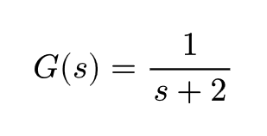
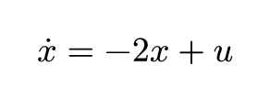
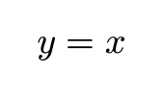
Linear Time-Invariant (LTI) Systems and State-Space Representation
Linear Time-Invariant (LTI) Systems:
An LTI system is a mathematical model whose parameters remain constant over time and whose behavior satisfies the principles of linearity and time invariance.
The state-space representation used in Scilab is
where the matrices define the system dynamics. Example: For the transfer function
The state-space realization is : A=[−2],B=[1],C=[1],D=[0]

Slide 18
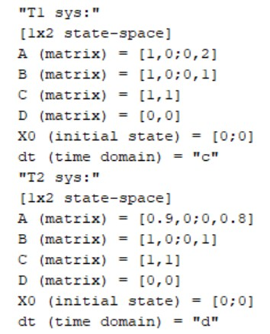
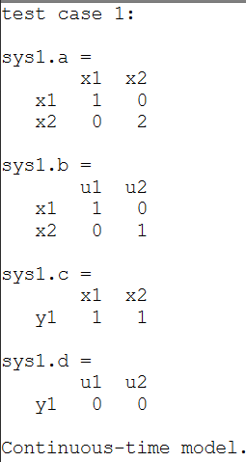
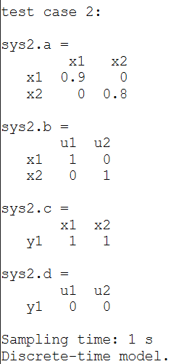
HORZCAT @ lti
horzcat horizontally concatenates two or more LTI systems, combining their inputs while preserving the same outputs. All systems must have the same number of outputs and compatible sampling times.
Depends on sys_group
Scilab Octave
Input:
sys1, sys2, ...
Output:
sys
Dependencies:
__sys_group__
Parameters:
sys1, sys2, ... – LTI systems to concatenate.
sys – Horizontally concatenated LTI system.

Slide 19
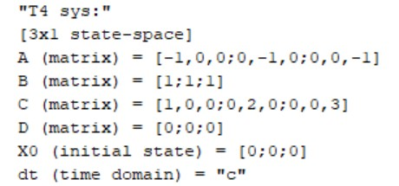
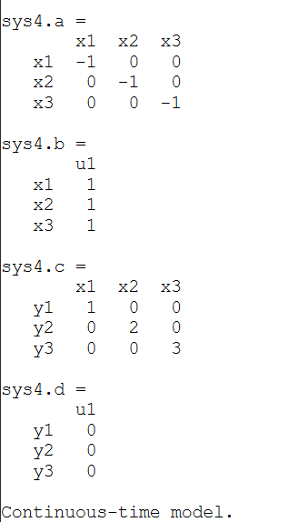
VERTCAT @ lti
vertcat vertically concatenates two or more LTI systems, combining their outputs while preserving the same inputs. All systems must have the same number of inputs and compatible sampling times.
Depends on sys_group
Scilab Octave
Input:
sys1, sys2, ...
Output:
sys
Dependencies:
__sys_group__
Parameters:
sys1, sys2, ... – LTI systems to concatenate.
sys – Vertically concatenated LTI system.

Slide 20
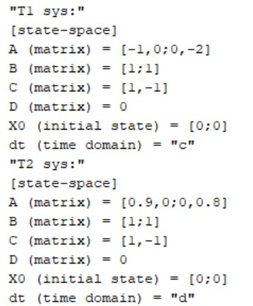
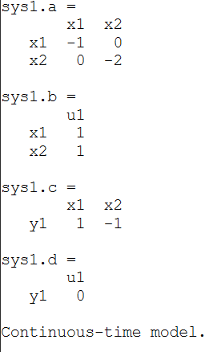
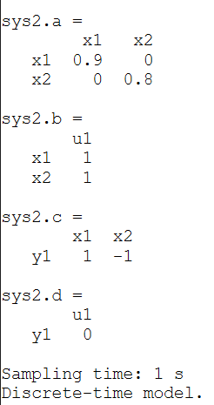
MINUS @ lti
Subtracts one compatible LTI system from another and returns the resulting system. Both systems must have identical input-output dimensions and compatible sampling times. The operation is implemented by grouping the systems and applying appropriate input/output scaling matrices.
Scilab Octave
Input: sys1, sys2
Output:
sys
Dependencies:
__sys_group__
Parameters:
sys1 - first LTI system sys2 - second LTI system
sys - resulting LTI system after addition.

Slide 21
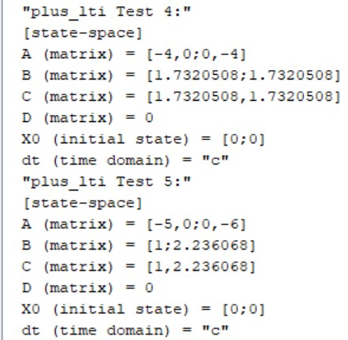
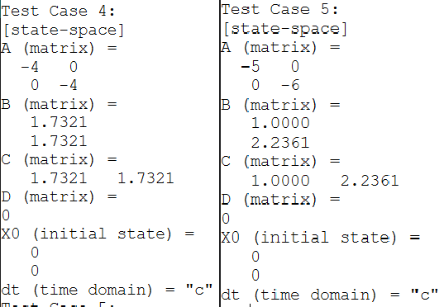
PLUS @ lti
Adds two compatible LTI systems and returns the resulting system. Both systems must have identical input-output dimensions and compatible sampling times. The operation is implemented by grouping the systems and applying appropriate input/output scaling matrices.
Scilab Octave
Input: sys1, sys2
Output:
sys
Dependencies:
__sys_group__
Parameters:
sys1 - first LTI system sys2 - second LTI system sys - resulting LTI system after addition.

Slide 22
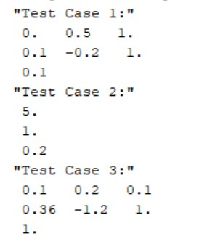
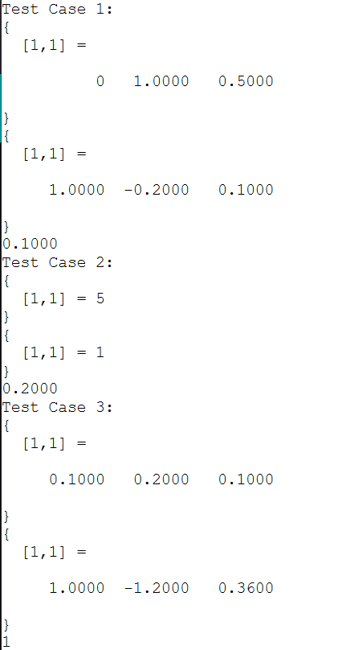
FILTDATA
Performs vertical concatenation of transfer function models, combining systems with the same number of inputs into a taller transfer-function matrix. Returns the concatenated transfer-function object while preserving compatible LTI properties through lti_group
Scilab Octave
Input:
sys, rtype (optional) Output:
num, den, tsam
Dependencies:
tf, tfdata, isdt, issiso, prepad
Parameters: sys – function. rtype –
Discrete-time transfer
Output format ("cell" or
"vector" for SISO systems).
num – Numerator coefficient vector(s).
den – Denominator vector(s).
tsam – Sampling time.
coefficient

Slide 23
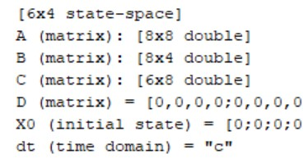
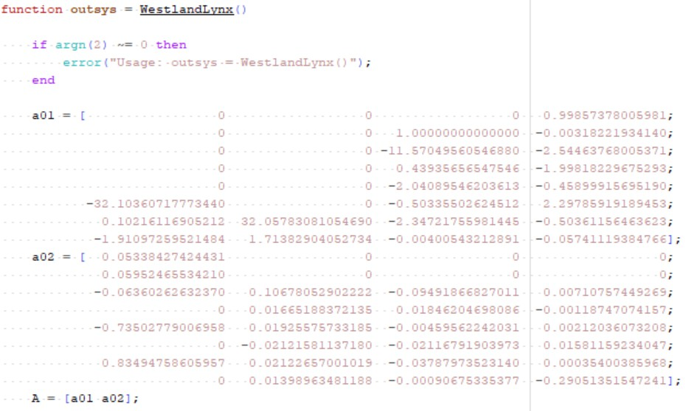

WESTLANDLYNX
westlandlynx returns the linearized state-space model of the Westland Lynx helicopter, a well-known benchmark aircraft used in control systems research. The model is commonly used for studying multivariable control design, state estimation, system identification, and robustness analysis of helicopter dynamics. It provides the helicopter dynamics as an LTI state-space system suitable for simulation and controller development.
Code snippet

Slide 24
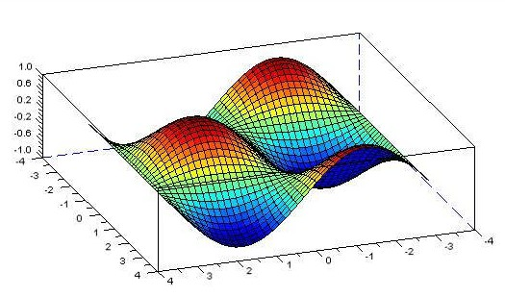
Conclusion
I was able to build a set of control system functions in native Scilab that didn't exist in the toolbox before, using Octave's neat documentation.
The hardest part for me was reconstructing SLICOT-dependent logic using Scilab's own tools, testing constantly against Octave's output to make sure I'd actually gotten it right.
AI tools helped me debug and learn faster along the way. AI could help expand this toolkit to people who feel intimidated by control systems.
Future Scope
Kalman & Filtering: the next step: with state-space and controllability/observability work already done, extending into Kalman filtering and related estimation tools is the logical next milestone for the toolbox.
tf & bode: these two are frequently used functions that need to be revamped in Scilab

Slide 25
Thank You

