Slide 1




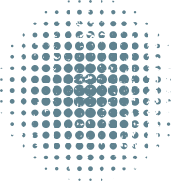
SUMMER FELLOWSHIP REPORT
ON
CREATION OF SCILAB CASE STUDIES
SUBMITTED BY
CHIRAG VEERWANI
INDIAN INSTITUTE OF TECHNOLOGY HYDERABAD
UNDER THE GUIDANCE OF
PROF. PRABHU RAMACHANDRAN
CHEMICAL ENGINEERING DEPARTMENT
IIT BOMBAY
MENTOR
MRS. RASHMI PATANKAR
JULY 3, 2026

Slide 2
CASE STUDY 1: MODELING AND SIMULATION OF SATELLITE ORBIT DYNAMICS AND ORBIT CONTROLLER USING SCILAB AND XCOS
Abstract:
This case study proposes to model and simulate the orbital dynamics of a satellite in a circular orbit and design a feedback-based orbit correction controller using Scilab and Xcos, based on the IEEE paper mentioned below. Satellites deviate from their ideal orbits due to perturbations such as atmospheric drag and gravitational anomalies. The orbital equations of motion derived from Newton’s law of gravitation will be solved numerically using Scilab’s ode() function to simulate the satellite trajectory and the effect of perturbations on altitude. A PID controller will then be designed and simulated using Xcos block diagrams, where the altitude error serves as feedback and thruster force as the control output, to restore the satellite to its desired orbit. Results will include trajectory plots and Xcos controller response simulations

Slide 3
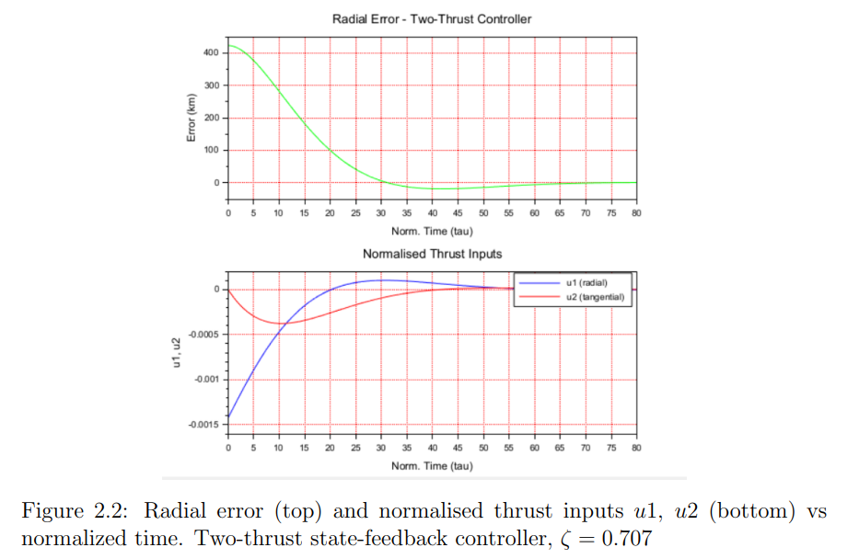
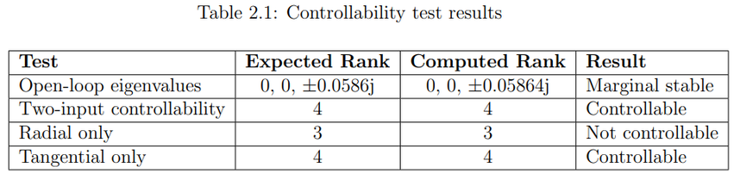
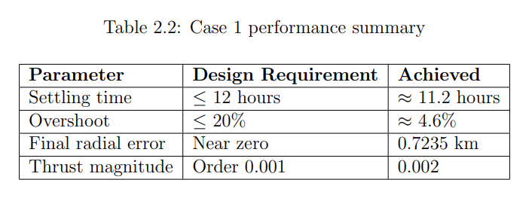
RESULTS AND DISCUSSION
CONTROLLABILITY VERIFICATION
The console output confirmed that the linearized system is marginally stable in open loop and meets all three rank conditions as derived in the reference paper.
CASE 1: TWO-THRUST CONTROLLER
The satellite started 422 km above its target orbit. The two-thrust state-feedback controller with ζ = 0.707 and ωn = 0.1058 drove the radial error from +422 km to approximately 0.7235 km, effectively zero within normalized time τ ≈ 50, which corresponds to about 11.2 hours. This is within the 12-hour design requirement.
The angular rate error also converged to zero, confirming that the satellite stabilized at the correct orbital angular velocity. The response shows a single underdamped oscillation before settling, consistent with the chosen damping ratio of 0.707.

Slide 4
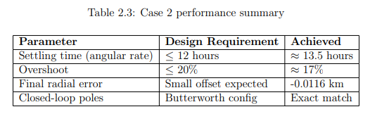
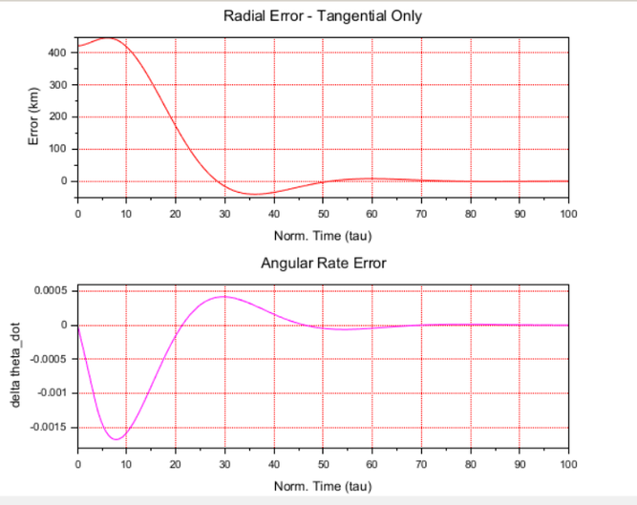
CASE 2: TANGENTIAL-ONLY CONTROLLER
Using only the tangential thruster, the angular rate error successfully converged in approximately 13.5 hours with accurately placed closed-loop poles. As theoretically predicted, a minor constant radial offset (-0.0116 km) remained. This confirms the model's accuracy, demonstrating that a single-thruster system can stabilize orbital speed but cannot perfectly correct the orbital radius.
XCOS NONLINEAR SIMULATION
The Xcos block diagram implemented the nonlinear radial plant directly using the expression block ρω2−1/ρ2 , which is the exact radial acceleration equation from the paper. A PID controller replaced the state-feedback law for the Xcos simulation, and a random generator block was added to simulate continuous orbital perturbations. The output showed the orbital radius starting at 6.6917 (1% above ρss) and settling smoothly to 6.625 within the simulation time of 500 normalized units. This confirms the nonlinear model is physically consistent with the linearized simulation results.
Figure 2.3: Case 2: Radial error (top) and angular rate error (bottom) vs normalized time. Tangential-only controller, ζ = 0.5

Slide 5
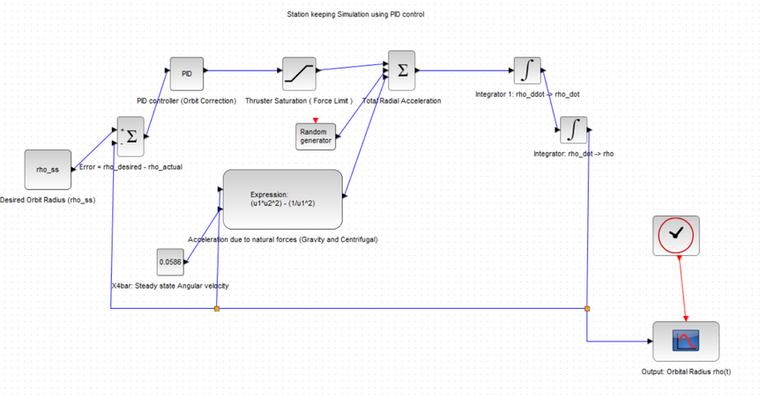
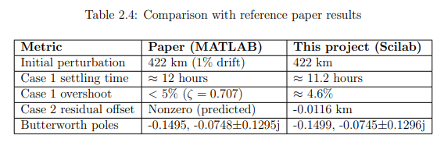
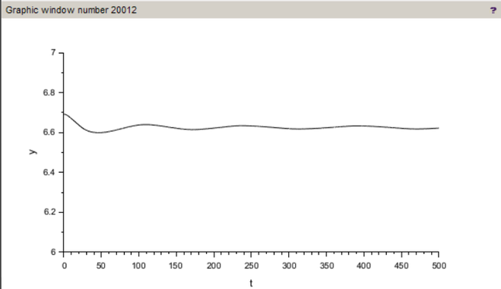
COMPARISON WITH REFERENCE PAPER
The reference paper used MATLAB 5.3 and reported simulation results for a satellite with a 1% orbital drift in a geostationary orbit. This project replicated the same problem in Scilab and obtained results that closely match the paper:
Figure 2.4: Xcos block diagram of the satellite orbit controller
CONCLUSION AND PROJECT SCOPE
This project successfully validated the reference paper's core principles using Scilab and Xcos, making necessary practical adjustments to the scope:
  Fully Implemented: Exact nonlinear equations of motion, linearized A and B matrices (matching within 0.1%), all three controllability tests, and the tangential-only Butterworth controller (poles and gain matched exactly).
  Key Modifications: Replaced the paper’s simplified steady-state radius (ρss = 1) with a real-world Earth scale (ρss = 6.625). Because this alters the satellite's angular acceleration, the control laws were analytically re-derived for the new baseline while adhering to the original performance criteria.
  Not Implemented: The comparative pole-placement study (only the final design was simulated), alternate altitudes (strictly restricted to geostationary orbits), and full state-feedback in Xcos (a PID block was used instead to simplify complex signal routing, which still produced a physically accurate response).
Figure 2.5: Xcos simulation result, orbital radius converging to steady-state value ρss = 6.625

Slide 6
CASE STUDY 2: INTERACTIVE GUI-BASED IMPLEMENTATION OF GENTAMICIN ELUTION KINETICS FROM ANTIBIOTIC-LOADED PMMA BONE CEMENT USING SCILAB
Abstract:
This case study implements an interactive Scilab based graphical user interface (GUI) to model and visualize the kinetics of gentamicin elution from antibiotic loaded poly(methyl methacrylate) (ALBC) bone cement over a 28 day elution period, based on the experimental findings of the reference paper mentioned below. Seven cement formulations are considered: a commercial control cement, three MEPAR ( microencapsulated paraffin) loaded variants and three DDM (1-dodecyl mercaptan) loaded variants. For each formulation, four widely used kinetic release models are implemented: the KorsmeyerPeppas power law, the LindnerLippold modified power law, the Frutos et al. combined diffusion-dissolution model, and the Hesaraki et al. exponential model using the best fit coefficients as reported in the paper. The GUI allows the user to select any cement group and any kinetic release model interactively, rendering the corresponding Mt/M∞ verses time curve alongside digitized experimental data. This helps the user to easily compare and choose the kinetic model according to their preferences. Additional features include overlay of all seven groups for cross-group comparison and a bar chart with error bars for gentamicin diffusion coefficient. The study demonstrates that neither MEPAR nor DDM addition significantly alters the gentamicin diffusion of the diffusion mechanism as reported in the paper. This case study performs a partial replication of Lewis and Li (2019), focusing on visualization and comparison of the reported kinetic models and diffusion coefficients using Scilab. The original diffusion coefficient computation, nonlinear fitting procedures, statistical analyses, and experimental measurements were not reproduced.

Slide 7
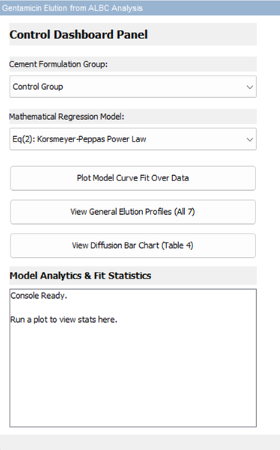
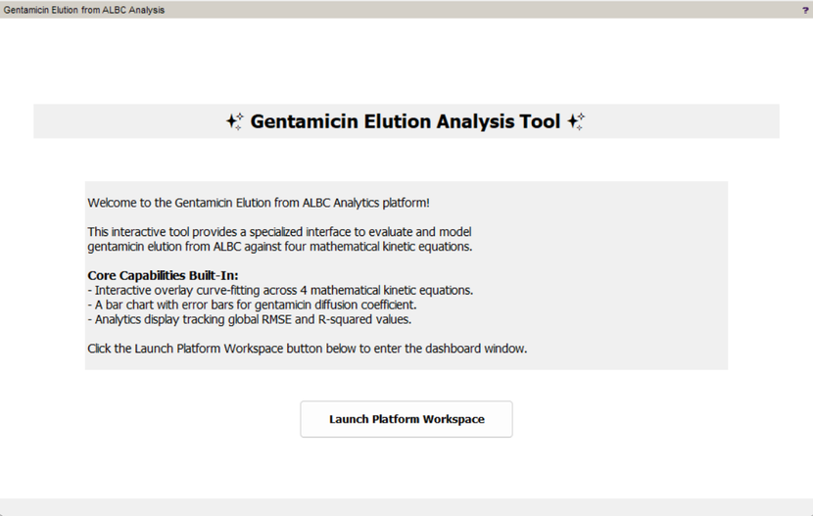
RESULTS AND DISCUSSION
APPLICATION STARTING WINDOW AND THE DASHBOARD
The GUI window titled ’Gentamicin Elution from ALBC Analysis’ provides a specialized interface to evaluate and model gentamicin elution from ALBC against four mathematical kinetic equations. Core capabilities built into the dashboard include interactive overlay curve-fitting across the four models, a bar chart with error bars for the gentamicin diffusion coefficient, and an analytics display tracking global RMSE and R-squared values.
Figure 3.2: Application window starting and Control Dashboard Panel of the Gentamicin Elution Analysis Tool
MODEL CURVES FOR EACH GROUP AGAINST KINETIC EQUATIONS
By selecting a cement formulation group and a mathematical regression model, the GUI plots the modeled curve (red) overlaid on the normalized experimental points. The equation formula and the coefficients are also displayed in the plot. This feature enables users to directly compare how well each mathematical model describes the real-world elution behavior of any given formulation.

Slide 8
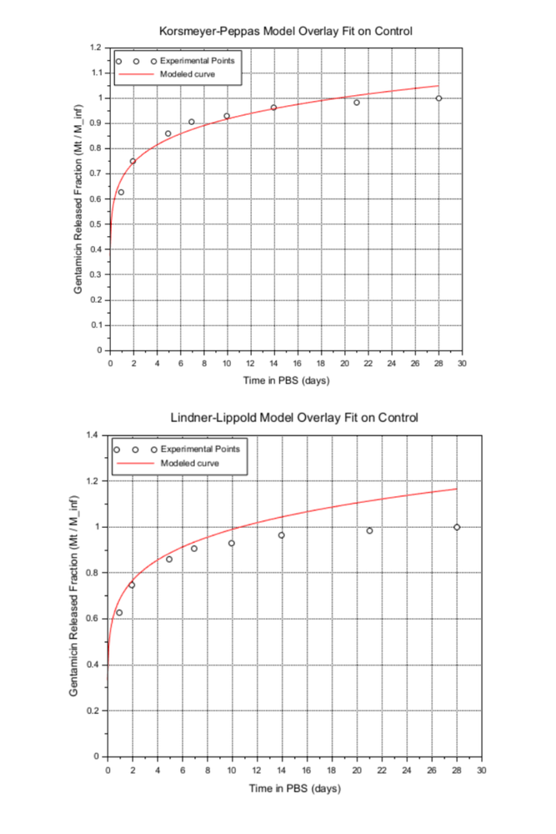
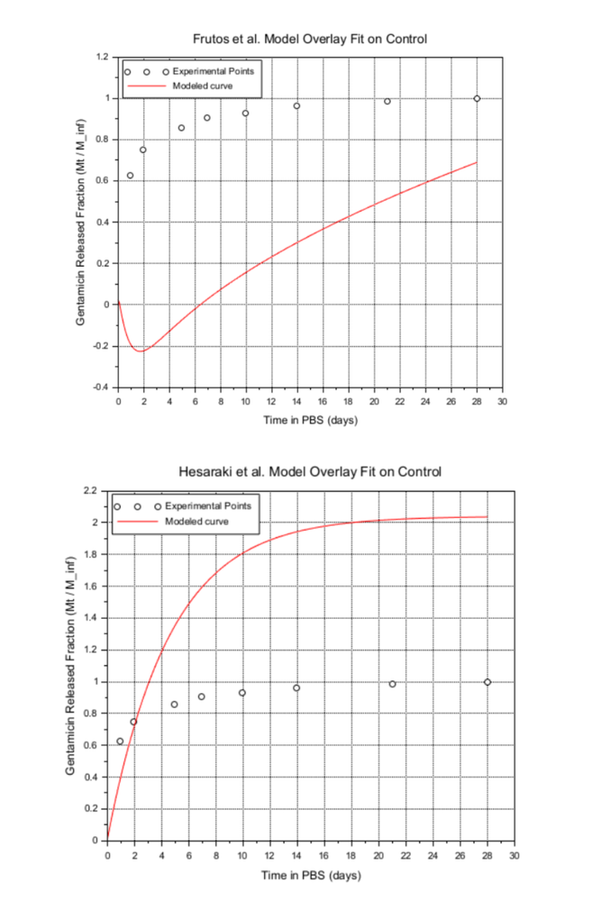
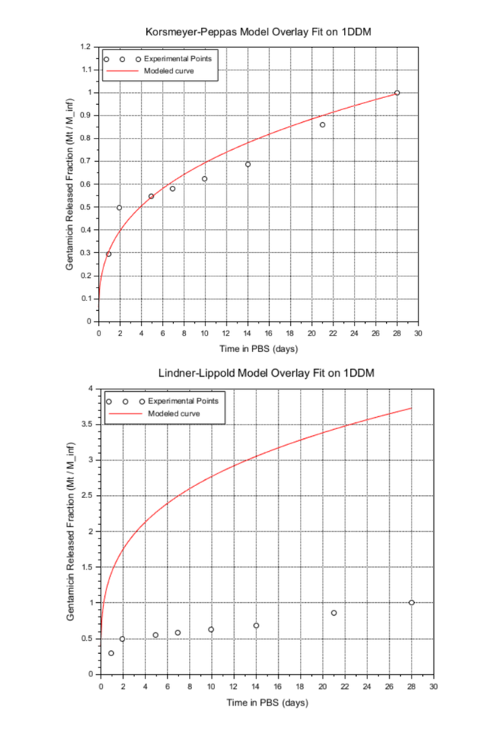

Slide 9
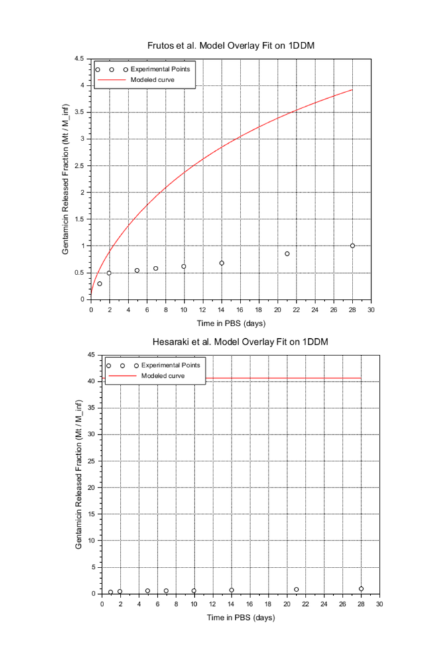
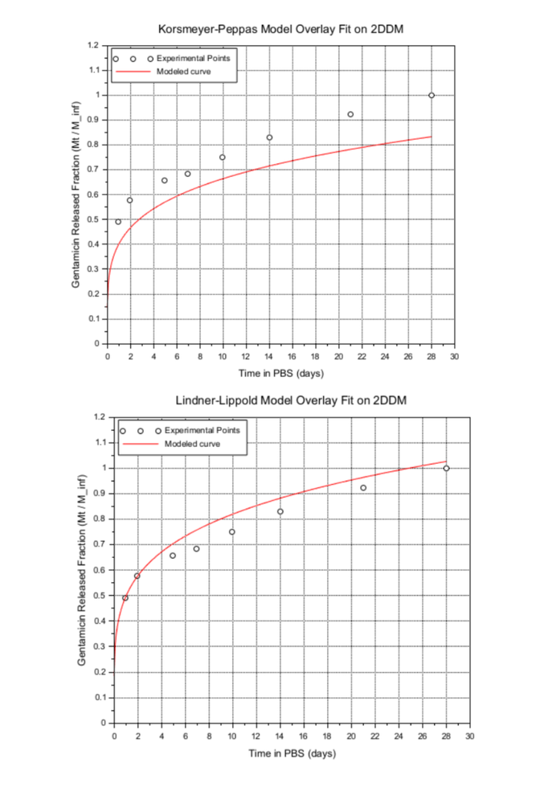
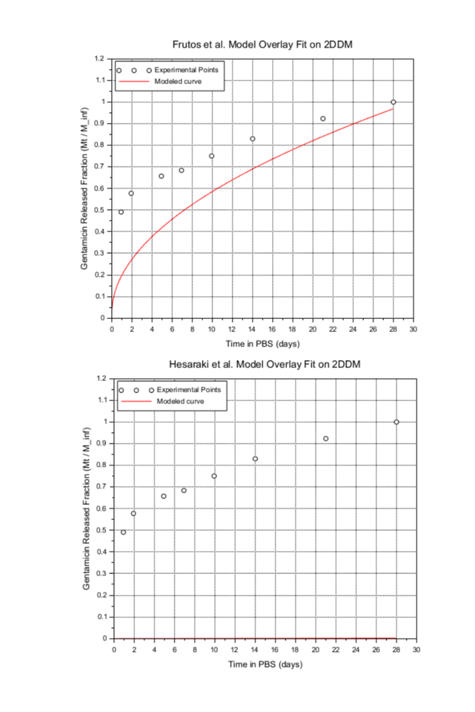

Slide 10
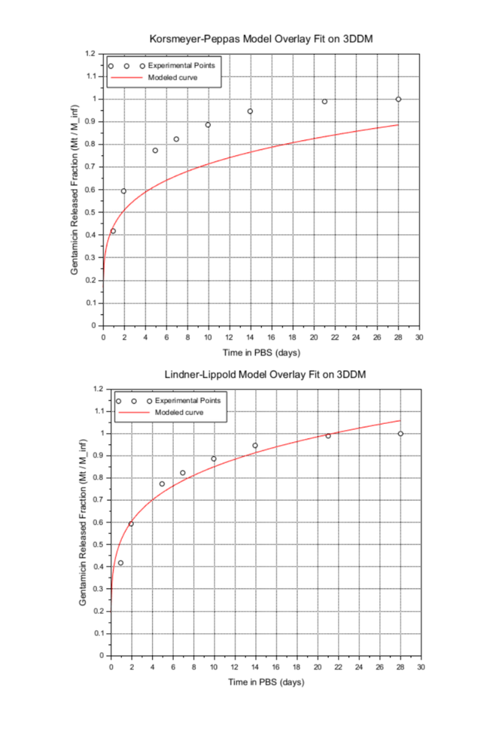
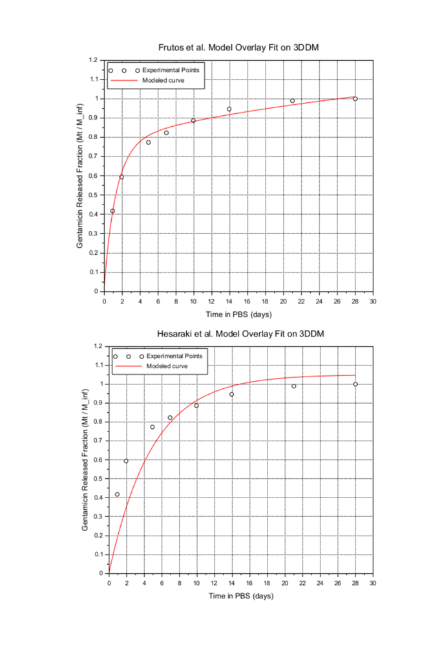
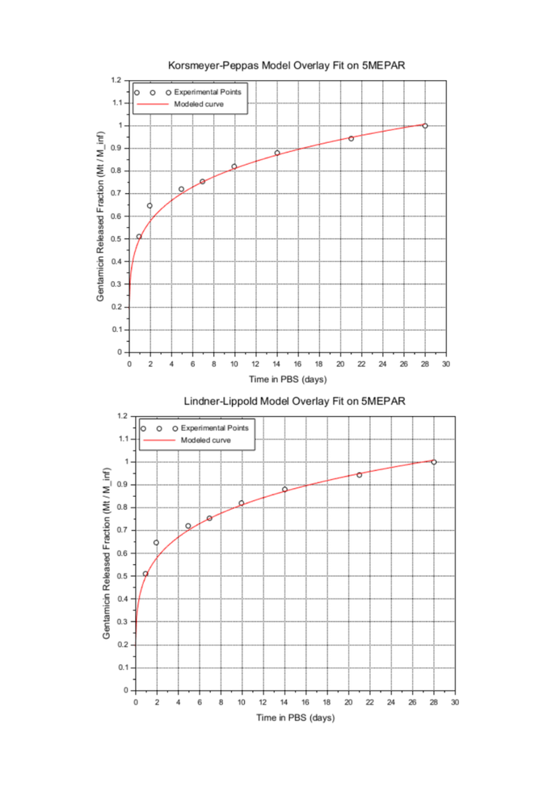

Slide 11
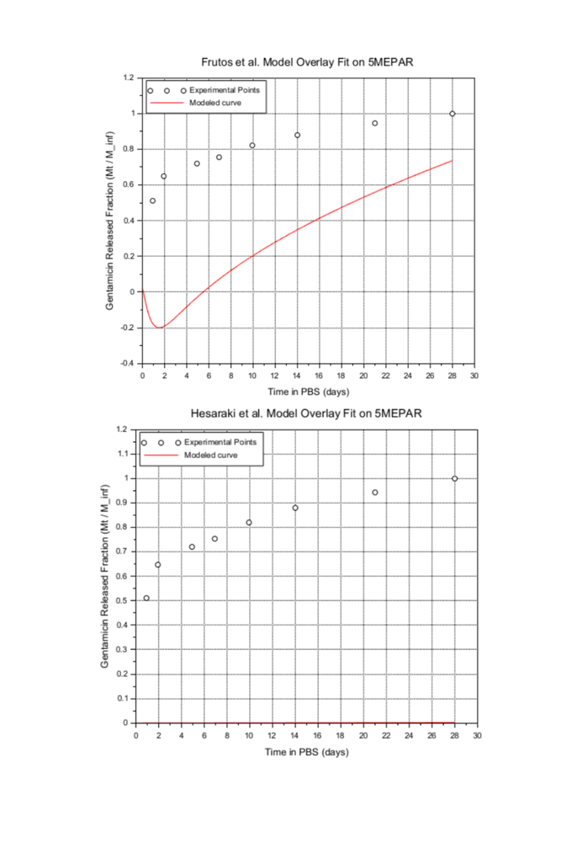
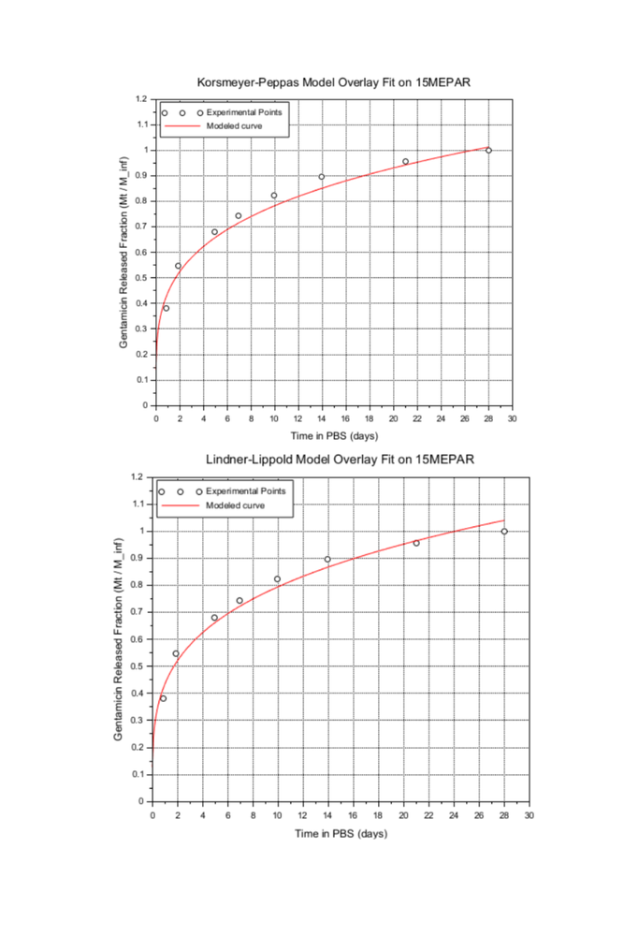
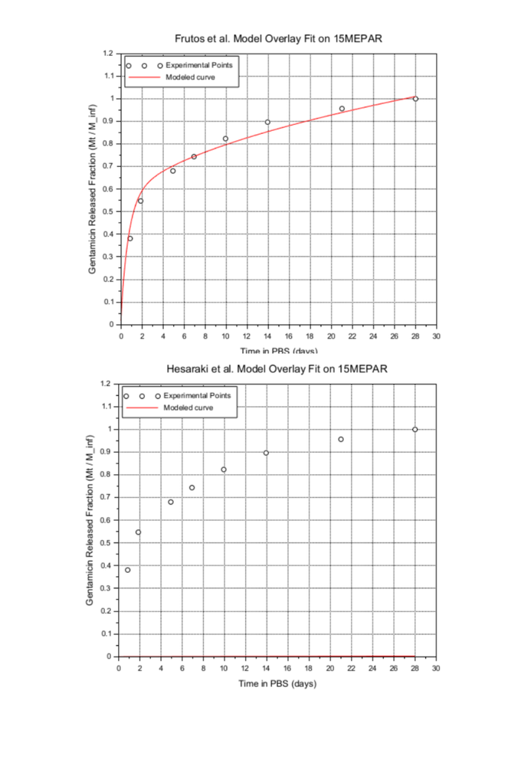

Slide 12
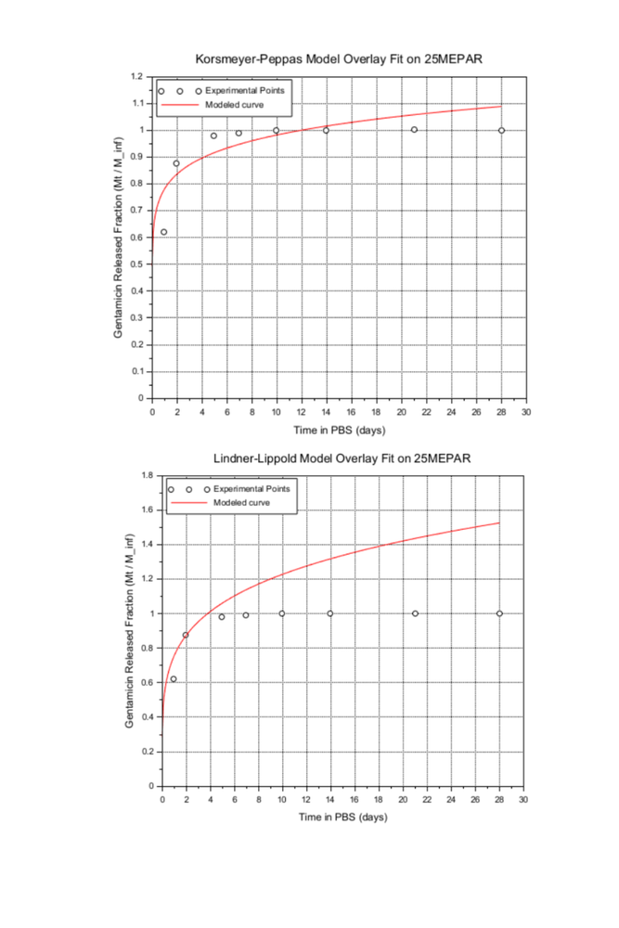
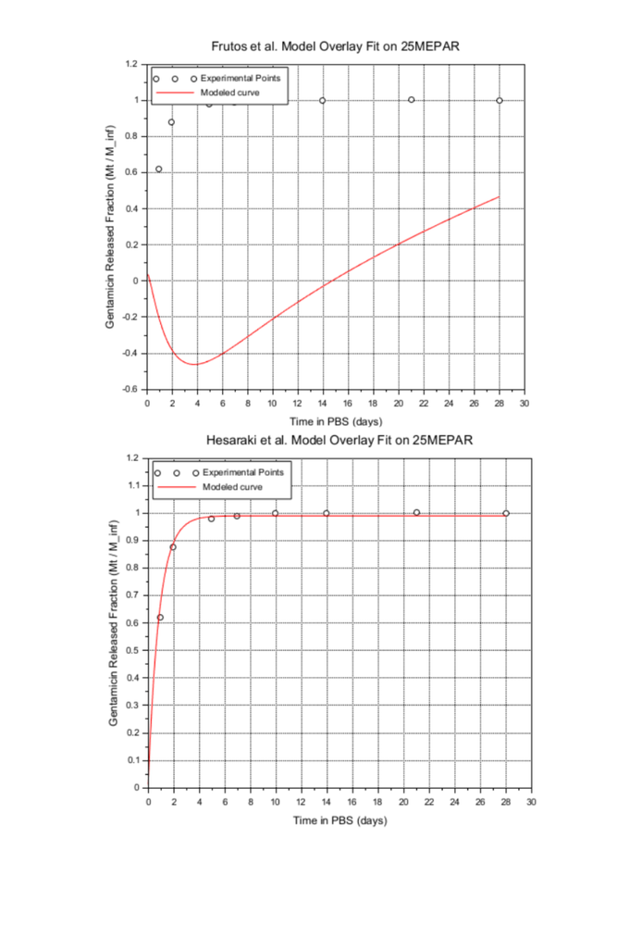
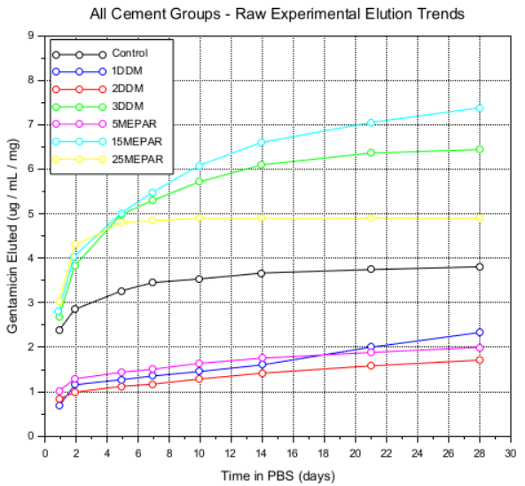
CROSS-GROUP OVERLAY PLOT
Figure 3.10: All Cement Groups - Raw Experimental Elution Trends

Slide 13
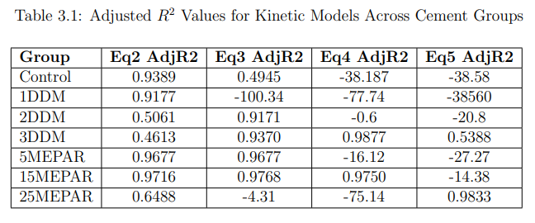
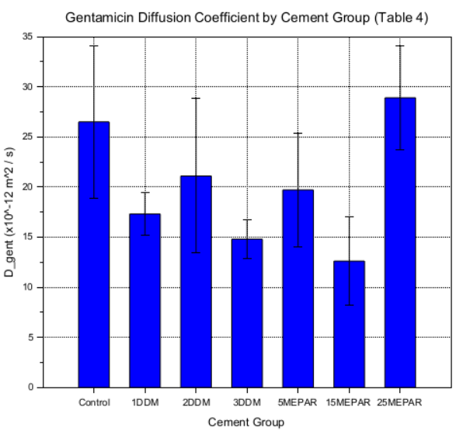
DGENT BAR CHART
ADJUSTED R2 VALUES
The gentamicin diffusion coefficient (Dgent) values range from 12.6 × 10−12 m2/s (15MEPAR) to 28.9×10−12 m2/s (25MEPAR), as visualized in the tool’s bar chart.
The table below summarizes the computed adjusted R2 values across all seven cement groups and the four kinetic equations.
CONCLUSIONS AND PROJECT SCOPE
This case study developed an interactive Scilab GUI to visualize gentamicin elution kinetics, confirming the paper's conclusion that MEPAR and DDM additives do not meaningfully alter the cement's core diffusion mechanism. The tool enables direct visual comparison of four kinetic release models (Korsmeyer-Peppas, Lindner-Lippold, Frutos et al., and Hesaraki et al.) across seven cement formulations.
  Fully Implemented: The four kinetic equations using exact published coefficients, Dgent statistical values, digitized 28-day experimental data, and all primary comparative plots (model curves, cross-group overlays, and bar charts).
  Modifications Made: Because the original mathematical equilibrium values were not published, they were approximated using day-28 data, introducing a minor normalization error. Additionally, using manually digitized graph data instead of raw per-specimen data introduced a slight spatial uncertainty.
  Not Implemented: The original numerical $D_{gent}$ computations, nonlinear least-squares fitting routines (coefficients were hardcoded instead), and complex statistical analyses (e.g., Kruskal-Wallis test) were excluded due to the unavailability of the raw per-specimen data.
Figure 3.11: Gentamicin Diffusion Coefficient by Cement Group

Slide 14
CASE STUDY 3: COMPARATIVE STUDY OF LINEAR AND NONLINEAR SWELLING KINETICS IN SUBSTRATE CONSTRAINED HYDROGELS
Abstract:
This case study implements the constrained swelling problem from Bouklas and Huang’s comparison of nonlinear and linear poroelasticity theories. A hydrogel layer bonded to a rigid substrate swells only through the thickness while solvent diffuses in from one exposed face. The nonlinear stretch field is found by solving a nonlinear diffusion equation in Scilab using an explicit finite difference scheme, with the surface boundary value fixed by solving a nonlinear algebraic equation using fsolve and a no-flux condition at the substrate.
The resulting thickness swelling curves are compared against the linear poroelasticity solution, computed as a truncated infinite series, using the same initial swelling ratio and material parameters as the paper. The case study reproduces the thicknessversus-time curves and equilibrium swelling ratio comparison shown in Fig. 2a, 3a, 6 and 7 of the paper, showing where the linear theory’s prediction departs from the nonlinear one as the swelling ratio grows.

Slide 15
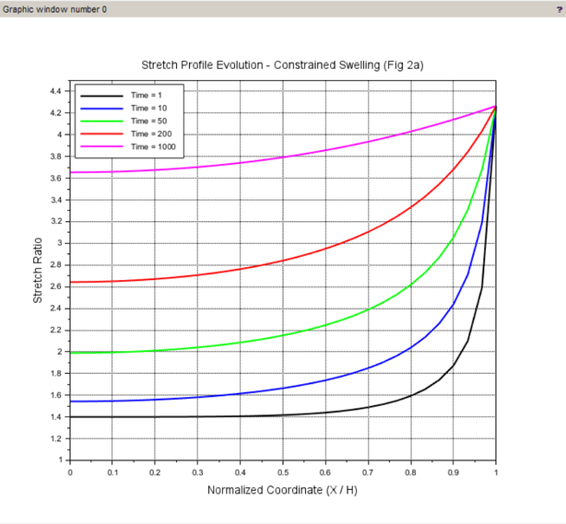
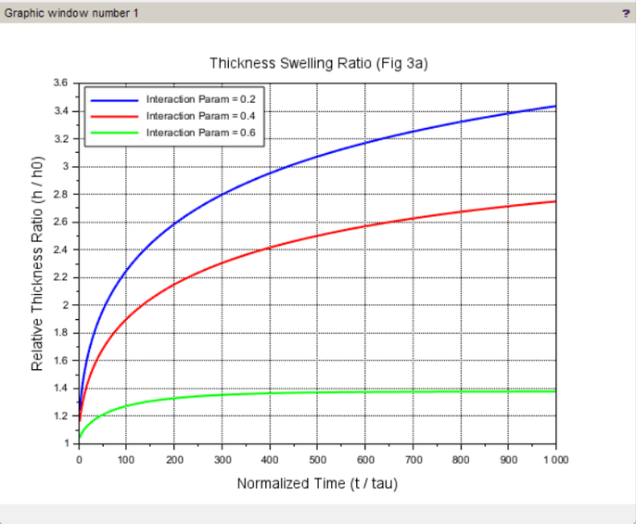
RESULTS AND DISCUSSION
SPATIAL DISTRIBUTION OF STRETCH (FIGURE 2A)
THICKNESS SWELLING KINETICS FOR VARYING
INTERACTION PARAMETERS (FIGURE 3A)
The first simulation tracks how the local stretch ratio (λ2) distributes itself across the normalized thickness coordinates of the hydrogel (X2/H) at various stages of time (t/τ1). The bottom surface at X2/H = 0 is fixed to the rigid substrate, and the top surface at X2/H = 1 is exposed to the solvent.
The second simulation evaluates the macroscopic thickness swelling ratio (h(t)/h0) over a normalized time window for three distinct Flory-Huggins interaction parameters (χ = 0.2, 0.4, and 0.6).
Figure 4.3: Relative thickness swelling ratio as a function of time for different values of the interaction parameter chi, including horizontal dashed equilibrium lines
Figure 4.2: Evolution of local stretch profiles across the normalized hydrogel thickness at increasing time intervals

Slide 16
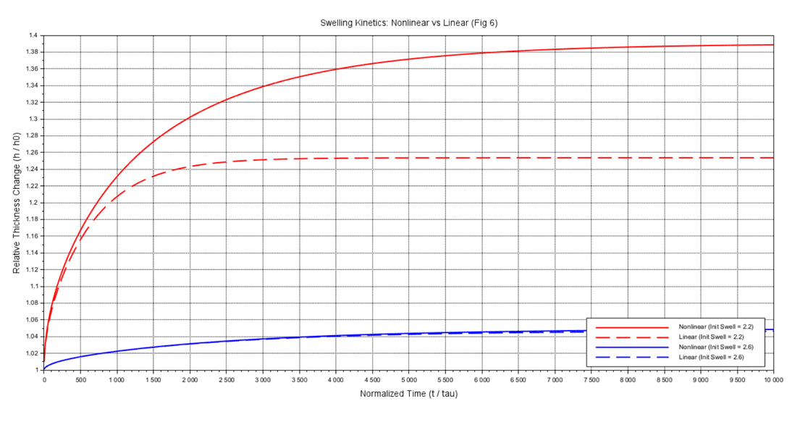
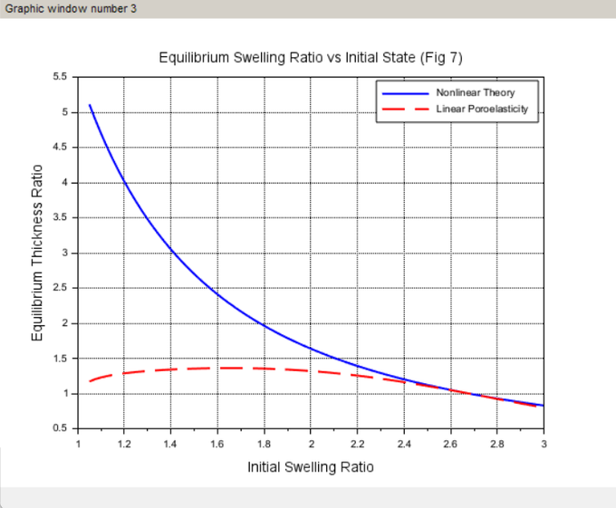
TRANSIENT DIVERGENCE BETWEEN LINEAR AND NONLINEAR
THEORIES (FIGURE 6)
GLOBAL EQUILIBRIUM CONVERGENCE AND DIVERGENCE MAP
(FIGURE 7)
This plot directly compares the transient expansion curves generated by the linear poroelasticity theory (solved via an analytical Fourier series) against the nonlinear continuum theory (solved via the FDM algorithm) across different initial swelling conditions.
The final result maps out the final steady-state thickness ratios predicted by both theories across a broad spectrum of initial swelling states (λ0).
Figure 4.4: Comparison of transient thickness changes over time between the linear analytical solution and the nonlinear numerical solution for different initial swelling states.
Figure 4.5: Global divergence map showing the final equilibrium thickness values predicted by the linear and nonlinear theories across a wide range of initial stretch states

Slide 17
IMPLEMENTATION SCOPE AND MODEL LIMITATIONS
NUMERICAL ANALYSIS AND DEVIATIONS
This project partially replicates Bouklas and Huang (2012) by focusing exclusively on substrate-constrained 1D swelling, intentionally omitting free-standing 3D expansion and surface instabilities (like wrinkling or buckling) to assume a perfectly flat gel.
The implemented model operates under three key constraints:
  Physical: It assumes a strictly 1D geometry, which is only valid if the gel's width and length vastly exceed its thickness (L, W >> H) to negate boundary edge effects.
  Thermodynamic: It relies on ideal Flory-Huggins mixing and a constant crosslink density.
  Numerical: The explicit Finite Difference Method (FDM) is strictly bound by the CFL stability condition, requiring a carefully scaled time step (dt) relative to the spatial grid (dX) to prevent mathematical instability.
The Scilab simulation successfully replicates the exact physical trends and steady-state plateaus of the original study, with only minor discrepancies arising from numerical discretization.
These slight deviations occur primarily during early-stage swelling, where the fixed 50-node spatial grid struggles to resolve sharp concentration gradients, causing localized truncation errors. Additionally, minute rounding errors from the root-finding convergence tolerance accumulate over millions of iterations, slightly altering the transient swelling speed before the system perfectly settles at the correct equilibrium.

Slide 18
THANK
YOU

