Slide 1


FOSSEE SUMMER FELLOWSHIP — PROGRESS PRESENTATION
Scilab Image Processing Toolbox Development
Presenter: Arjun E Naik | Mentor: Ms. Rashmi Patankar

Slide 2
Project Overview
The objective of this project to develop native Scilab implementations of Image Processing Toolbox functions by translating and optimizing Octave equivalents.
This fellowship focus on preserving Octave compatibility while adopting algorithms to Scilab’s architechture and programming model.
Core Motivation
Expand Scilab Open-Source capabilities.
Improve runtime performance
Support logical and image data types natively
Enable reproducible, self-contained Scilab code

Slide 3

Development Workflow
Read Octave
Translate to Scilab
Write Built-ins
Test & Validate
Each function follows this disciplined pipeline. Cross-validation against Octave output is the final gate before a function is marked complete.

Slide 4
Functions
Function
Description
entropy
Shannon entropy of image histogram
makelut
Creation of Lookup table given condition
entropyfilt
Local entropy filtering over sliding neighborhoods
rangefilt
Local range (max − min) filtering
stdfilt
Local standard deviation filtering
applylut
LUT-based neighborhood transform
bweuler
Euler number computation for binary images
checkerboard
Synthetic checkerboard test-pattern generator
roicolor
Region-of-interest extraction via hue/color range
grayslice
Partitions grayscale intensity range into intervals
fftconv2
2-D convolution using FFT
otsuthresh
Global threshold computation using Otsu's method
wavelength2rgb
Converts visible light wavelengths into RGB
bwmorph
Morphological operations on binary images

Slide 5
Functions:
1.entropy() - measures the amount of information ( randomness) present in an image.
2.makelut() - pre-computes the output of an arbitrary neighbourhood function for every possible binary input pattern, storing the results in a vector that can later be applied pixel-by-pixel at constant cost
3.entropyfilt() - slides a neighbourhood window (called domain) across every pixel of an image and computes the Shannon entropy of the intensity distribution within that window.
Calling Sequence:
Out = entropy(I,nbins);
whre,
I – real or logical array
nbins – positive integer scalar
Output:
E – scalar double
Calling Sequence:
E = entropyfilt(I);
E = entropyfilt(I, domain);
E = entropyfilt(I, domain, padding);
whre,
I – numeric or logical matrix
domain – numeric matrix (defalt ones(9,9) )
Padding – padding to image (default – symmetric)
Output:
E – Local entropy at every pixel (bits). Size same as I.
Calling Sequence:
Out = makelut(fun,n);
whre,
fun – condition function to create lookup table.
n - neighbhourhood length.
Output:
lut – column vector of doubles, length 2^(n²)

Slide 6
Functions:
4.rangefilt() - non-linear spatial image processing operation that replaces each pixel with the local range — the difference between the maximum and minimum pixel values within a defined neighbourhood.
5.stdfilt() - slides a neighbourhood window (called the domain) across every pixel of an image and computes the local standard deviation of intensity values within that window
6.applylut() - applies a neighbourhood look-up table (LUT) to a binary image. For every pixel in the image it examines the pixel's neighbourhood, converts that neighbourhood into an integer index, and replaces the pixel's output value with the entry at that index in the LUT
Calling Sequence:
retval = rangefilt(I)
retval = rangefilt(I, domain)
retval = rangefilt(I, domain, padding)
whre,
I – real or logical array
domain – numeric or logical matrix
Padding – pad to image.
Output:
E – double matrix.
Calling Sequence:
A = applylut(BW, LUT)
whre,
BW – logical matrix (any size >=3)
LUT – numeric column vector length of 512 .
Output:
A – double matrix . Same size as BW.
Calling Sequence:
S = stdfilt(I)
S = stdfilt(I, domain)
S = stdfilt(I, domain, padding)
whre,
I – real or logical array
domain – numeric or logical matrix
Padding – pad to image.
Output:
lut –doubles matrix,same length as I.

Slide 7
Functions:
7.bweuler() - The Euler number (also called the Euler characteristic or Euler–Poincaré number) is a fundamental topological property of a binary image.
E = C - H
where C is the number of connected foreground components (objects) and H is the total number of enclosed holes across all objects. Background regions that touch the image border are not counted as holes
8.checkerboard() - generates a synthetic checkerboard test pattern
9.roicolor() - Region of Interest by Colour (roicolor) produces a binary mask that identifies every element in an input array whose intensity value either lies within a closed range or matches one of a set of discrete target values.
Calling Sequence:
eul = bweuler(BW)
eul = bweuler(BW, n)
whre,
BW – real or logical matrix.
n – integer scaler (4 or 8)
Output:
E –scaler double
Calling Sequence:
BW = roicolor(A, low, high)
BW = roicolor(A, v)
whre,
BW – logical or numeric matrix
Low – lower bound.
High – upper bound.
V – numeric vector row or column..
Output:
BW – double matrix . Same size as A.
Calling Sequence:
checkerboard(side, M, N, P, ...);
whre,
side – non-negative integer (default 10)
M , N,P – single numeric integer.
No. of tiles along eah dimension.
Output:
lut –doubles matrix,2d or nd.

Slide 8
Functions:
10.graysclice() - partitions the intensity range of a grayscale image into a set of intervals (or levels) and produces a labeled image in which each pixel is replaced by the index of the interval it falls into.
Scalar input n → divides the range into n equally spaced levels.
Vector input v → uses the provided thresholds to define irregular intervals.
11.fftconv2() - performs 2-D convolution using the Fast Fourier Transform (FFT). The convolution is computed in the frequency domain, which is significantly faster than spatial convolution for large kernels
12.otsuthresh() - computes the global threshold of a histogram using Otsu's thresholding method. The algorithm determines the threshold that maximizes the between-class variance, thereby separating the histogram into two classes with maximum discrimination.
Calling Sequence:
s = grayslice(I);
s = grayslice(I,n);
whre,
I – numeric matrix.
n – integer scaler or vector (default 10)
Output:
E –uint8 or double labled image.
Calling Sequence:
X = fftconv2(a, b)
X = fftconv2(a, b, shape)
X = fftconv2(v1, v2, a)
X = fftconv2(v1, v2, a, shape)
whre,
a,b – numeric or logical matrices.
V1,v2 – numeric vectors.
Shape – for same size output ( default :”full”)
Output:
X –doubles matrix.
Calling Sequence:
T = otsuthresh(hist)
whre,
hist - numeric vector – histogram.
Output:
X –normalised otsu threshold between 0 and 1.

Slide 9
Functions:
13.wavelength2rgb - wavelength2rgb converts one or more visible light wavelengths (measured in nanometers) into their corresponding RGB colour representation
14.bwmorph() - Apply a named morphological transform to a binary image, n times (or until convergence with n = %inf)
Calling Sequence:
rgb = wavelength2rgb(wavelength)
rgb = wavelength2rgb(wavelength, out_class)
rgb = wavelength2rgb(wavelength, out_class, gamma)
where,
wavelength – numeric array in nano meters.
Out_class – double,uint8,uint16 datatypes.
Gamma – scalar numeric. Gamma correction factor.
Output:
rgb– numeric array rgb representation of input wavelengths
Calling Sequence:
bw2 = bwmorph(bw, operation)
bw2 = bwmorph(bw, operation, n)
whre,
bw – input binary image.
Operation name – like erode,dialate,thin,tophat,bothat etc.
N –no of iterations.
Output:
bw2 –Boolean matrix.

Slide 10
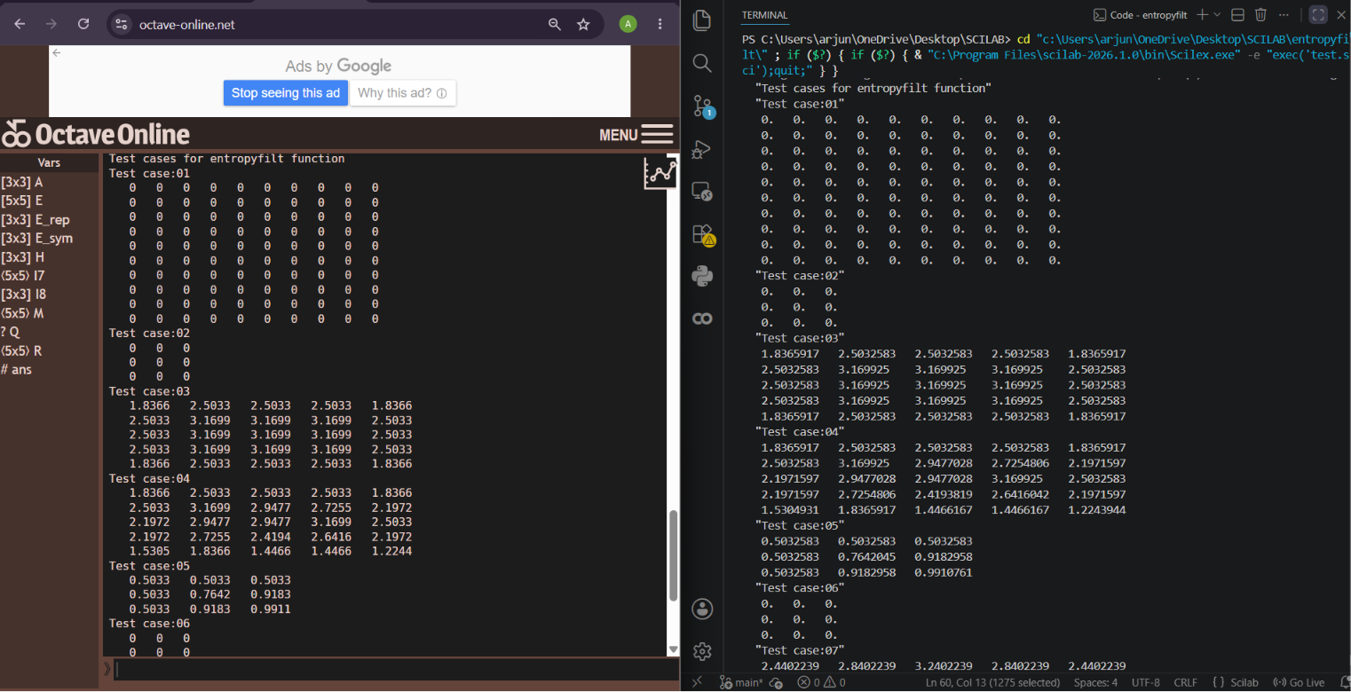
Example function execution: entropyfilt()

Slide 11
Key Technical Challenges
No Native Logical Type
Argument Count Mismatch
Scilab lacks a native logical type — explicit bool2s() conversion required throughout.
Octave's nargin/nargout map to Scilab's argn(2)/argn(1).
Convolution Kernel Orientation
Empty-Dimension Array Collapse
Column-major reshaping and conv2 kernel flipping required 180° pre-rotation in applylut.
Scilab's zeros() collapses empty-dimension arrays to 0×0, unlike Octave which preserves shape.
Missing Built-ins
Naming Collisions
Functions like im2uint8, imhist, immse, and getrangefromclass required custom narrow-scope helpers.
Scilab's flatter namespace caused collisions with existing macros (e.g., cell2mat), requiring renaming.

Slide 12
Documentation Approach
Every function ships with a consistent README following a five-part template, ensuring reproducibility and ease of adoption in lab and classroom settings.
01
02
03
Overview
Calling Sequence
Parameter Reference
Concise description of function purpose and mathematical basis.
All valid syntax variants with parameter signatures.
Type, shape, and valid range for each input and output.
04
05
Worked Examples
Octave Compatibility Notes
Reproducible Scilab snippets with expected console outputs.
Known behavioural differences, edge cases, and limitations.

Slide 13
Future Scope & Suggested Developments
Deep Learning Extension
Develop the function has computational
advantage
Integrate deep learning interference binding directly
With image toolbox to support native object detection
And segmentation tasks.
Reduce the time and space complexity with modern
discovered techniques.
Resolve Remaining Compatibility Issues
Performance Benchmarking
Systematically benchmark native Scilab implementations against Octave-bridged calls to quantify performance gains.
Investigate and address outstanding FOSSEE Scilab-Octave Toolbox compatibility gaps to reduce bridge dependency further.

