Slide 1


FOSSEE SUMMER FELLOWSHIP REPORT
SCILAB CASE STUDIES
AASHWIN VAIDYA
B.E, ELECTRONICS & TELECOMMUNICATION IET DAVV, INDORE, MADHYA PRADESH
GUIDE : PROF. PRABHU RAMACHANDRAN IIT BOMBAY | MENTOR : RASHMI PATANKAR
JULY 2026

Slide 2
Case Studies Overview
Music Genre Classifier Using Feed Forward Neural Network
Single-Digit DTMF Generator and Detector
using Goertzel Algorithm
ECG Signal Processing and Heart Rate Frequency Detection
Extracted features of 10,000 3 second audio files
Feed Forward Neural Network with Adam Optimization
Neural Convergence Curve and Heat Map to validate model
Sine waves and pulse signal for DTMF generation
8 Goertzel Detectors for effective frequency detection
Verification tests
ECG Signal uploading in .csv format
ECG Filtering to remove noise
R-Peaks filtering to estimate heart rate

Slide 3
Case Study 1: Music Genre Classifier using Feed Forward Neural Network
The Challenge:
Solution:
Unlike images, audio files are unstructured signals that cannot be directly fed into neural network
Training the network with mel spectrograms requires significant processing
Very slow training time
Replace heavy 2D Mel-Spectrogram image matrices low-dimensional statistical matrices
Uses feed forward neural network instead of convolutional neural network Significantly dropping the workload
Implement feature scaling and optimize hidden layer dimensions to enforce model generalization

Slide 4
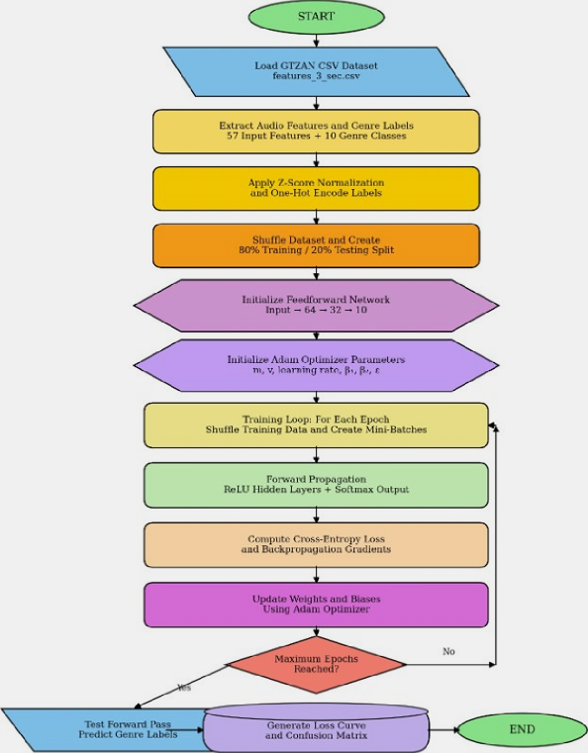
Key Features
Extracted 57 features from 10,000 audio files for training the model
Normalized and encoded the data to make it ready for training
Shuffled the dataset
Initialized a neural network with two hidden layers
ReLu and Softmax Activation Functions
Adam Optimization for updating weights and biases
Flowchart

Slide 5
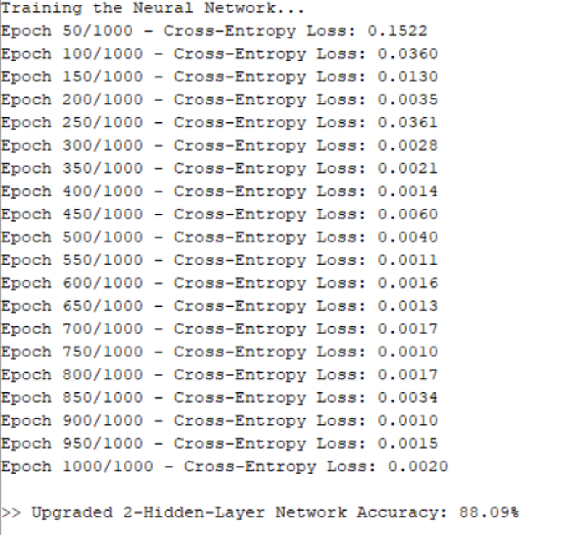
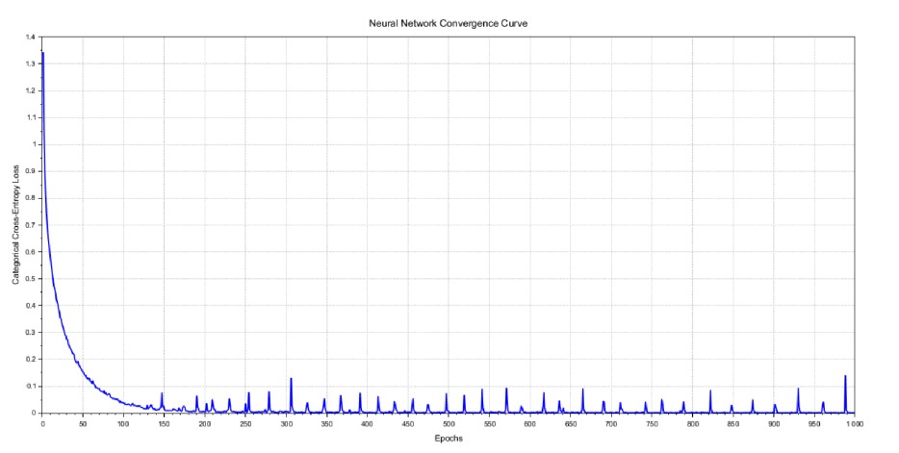
Results
Fig.01
Fig. 02
Neural Convergence Curve
Cross-Entropy Loss for every 50 epoches and training accuracy

Slide 6
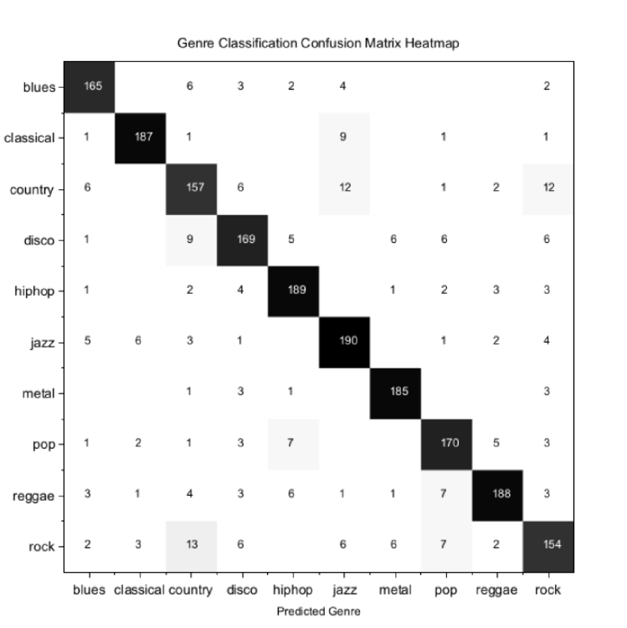
Results
Fig.03
Heat Map of Confusion Matrix

Slide 7
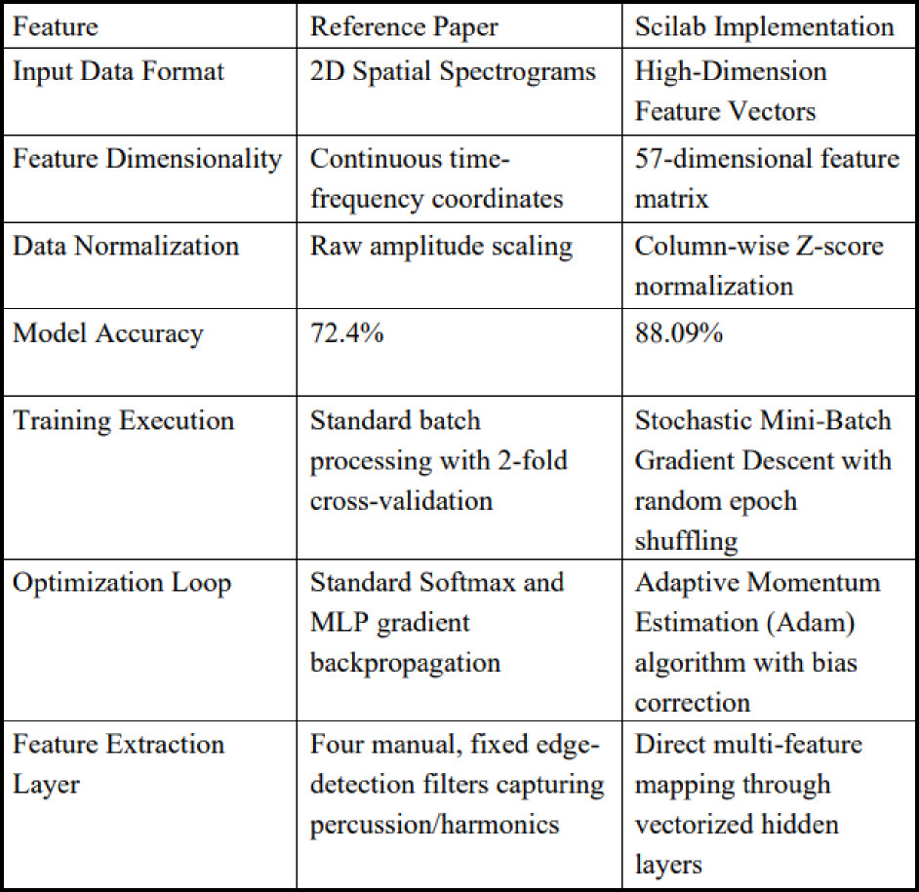
Result Comparison with Reference Paper

Slide 8
Case Study 2: Single-Digit DTMF Generator and Detector using Goertzel Algorithm
Objectives:
Key Features:
Generate a combination of two frequencies to represent a digit
Optimize Targeted Frequency Detection for Low Latency
Successfully decode the digit from the DTMF signal
Generates a Single DTMF Signal at a time
Utilizes bank of parallel digital Infinite Impulse Response (IIR) filters
Implements the Goertzel algorithm for discrete frequency detection
Rejects out of band speech signals
Validates the received signal using verification tests

Slide 9
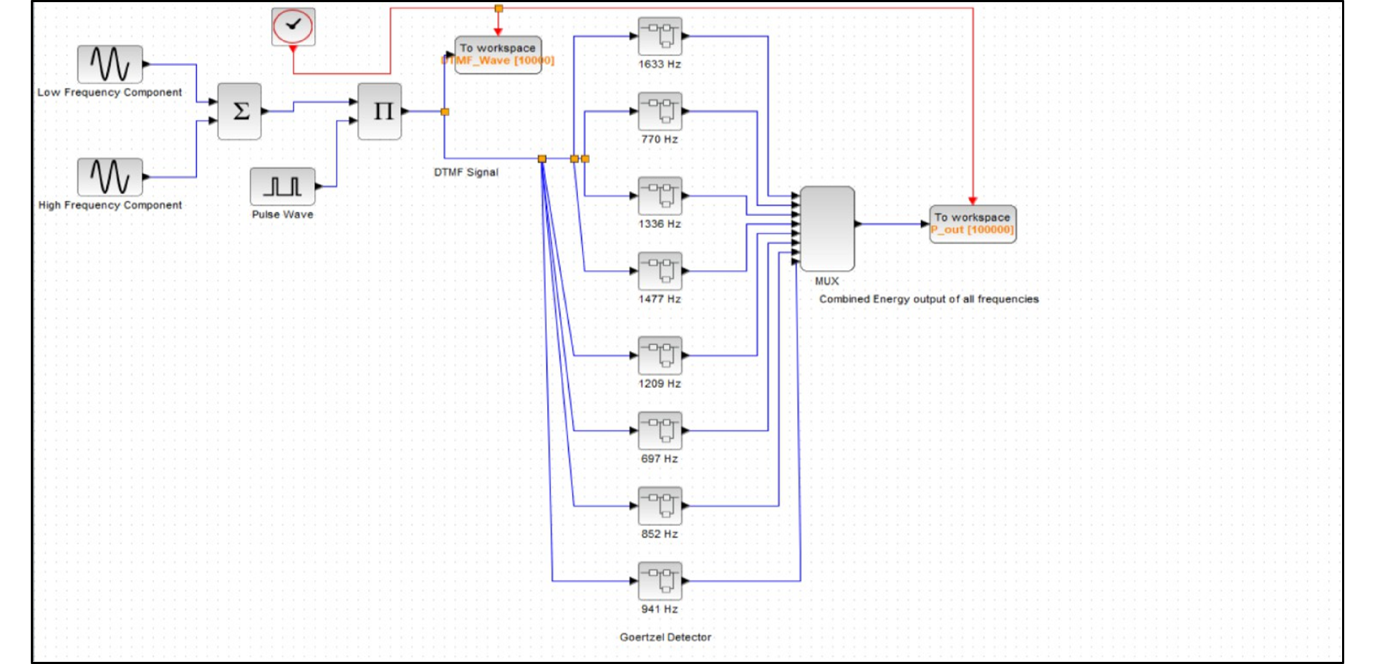
Xcos Diagram

Slide 10
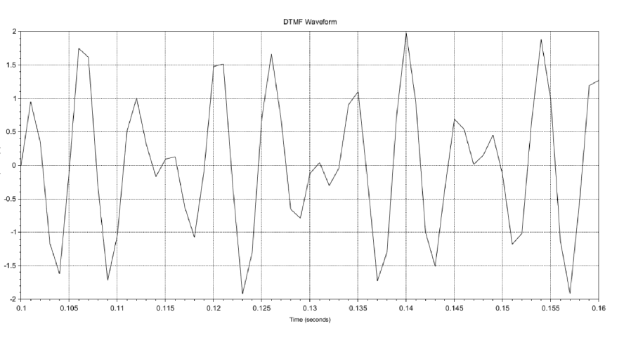
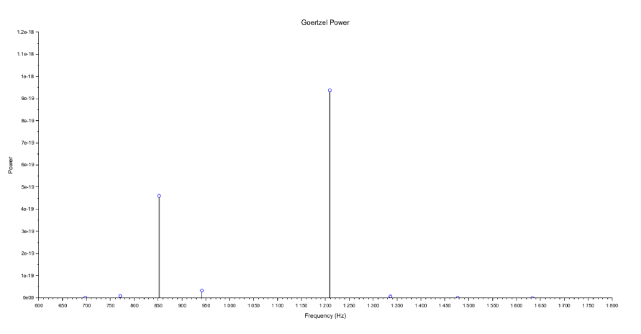
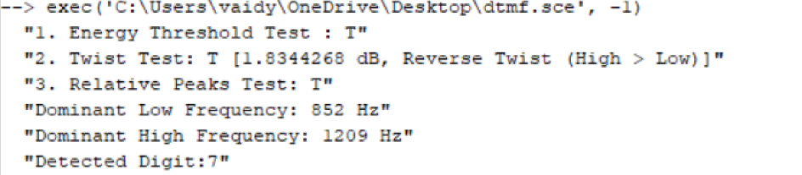
Results
DTMF Signal for Digit ‘7’
Energy Output for Digit ‘7’
Fig.01
Fig. 02
Fig.03
Validation Tests, Low Frequency, High Frequency and Successful Detection of Digit ‘7’

Slide 11
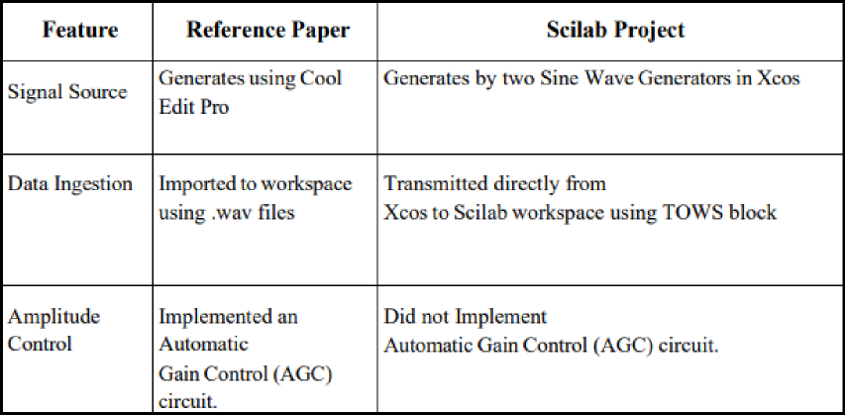
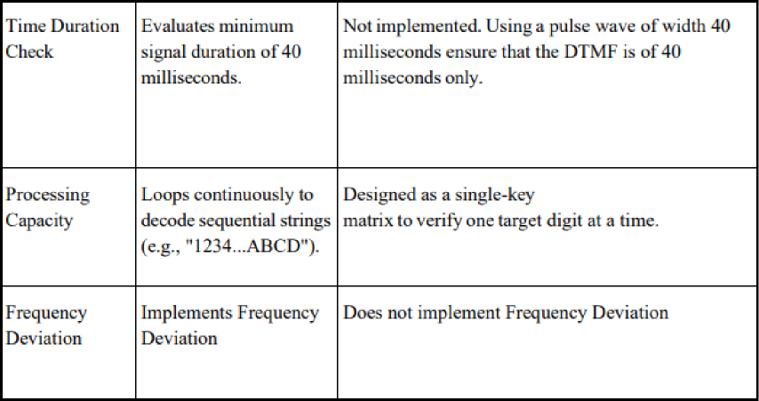
Result Comparison with Reference Paper

Slide 12
Case Study 3: ECG Signal Processing and Heart Rate Frequency Detection
Objectives:
Key Features:
Design a Biomedical Signal Processing Pipeline for analyzing ECG signals
Implement a Digital Filter Cascade for Noise Removal
Isolate and Detect Morphological Features
Compute Real-Time Diagnostics like Heart Beat
Uses a biquad notch filter configured to eliminate 50 Hz power
Uses a low-pass moving-average smoothing filter to remove low-frequency baseline wander caused muscle movement
QRS Complex Segmentation by amplifying the sharp slope while suppressing P and T waves.
Computes R-R intervals to output heart rate in BPM

Slide 13
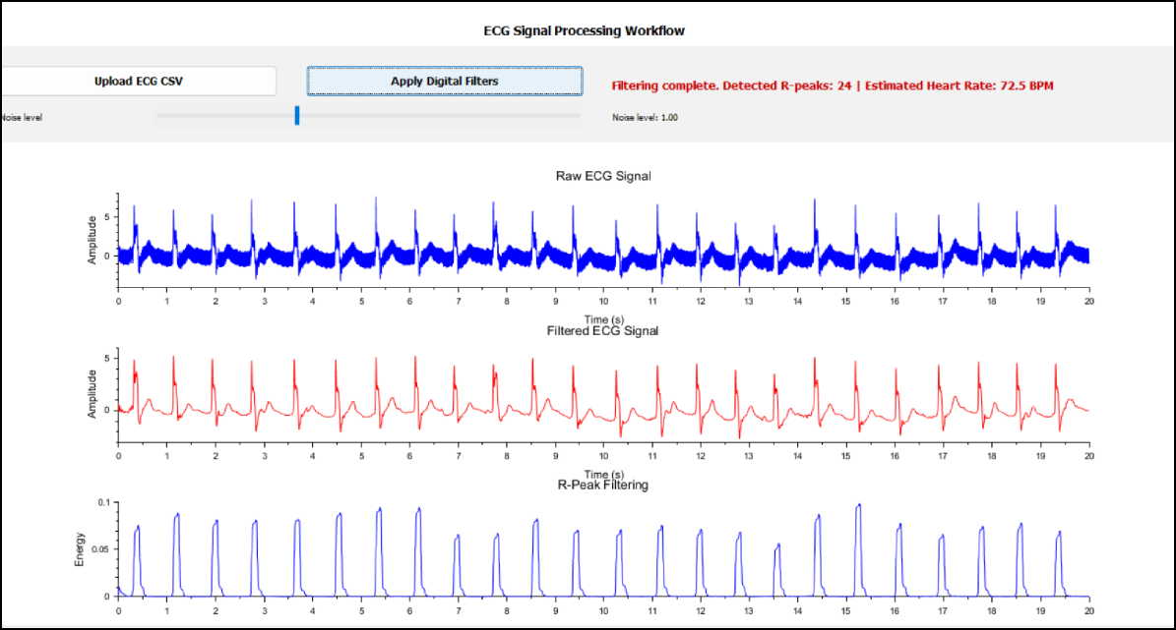
GUI Implementation
The GUI displays the raw ECG graph, the filtered graph and R-peaks filtered graph together for comparison
Implemented slider to dynamically change the amount of 50Hz noise
numeric indicators displaying heart rate (BPM) and calculated R-R intervals.
A simple interface to easily load raw clinical ECG data files directly into the Scilab workspace.

Slide 14
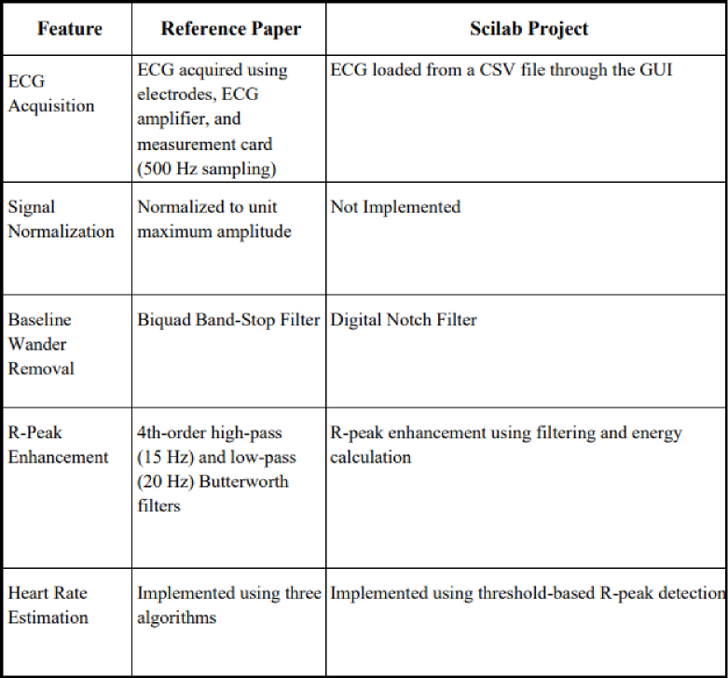
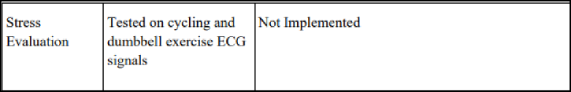
Result Comparison with Reference Paper

Slide 15
THANK YOU

